Slide 1
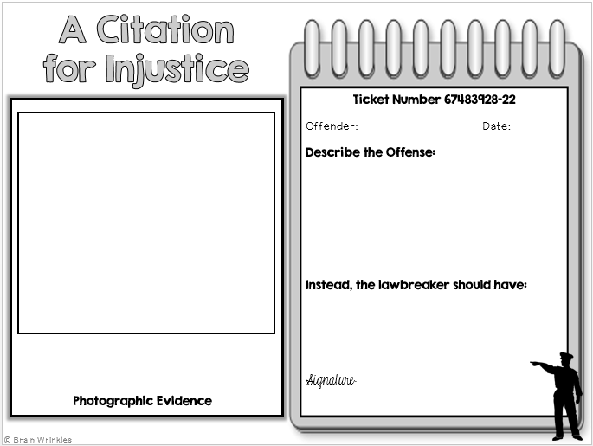
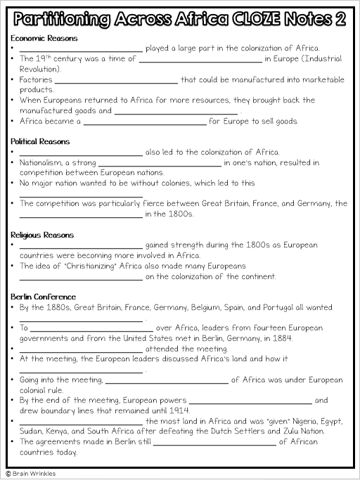
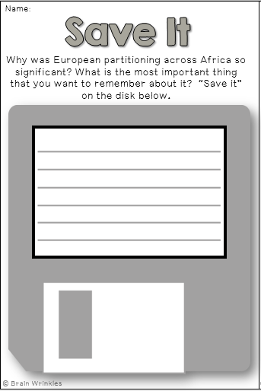
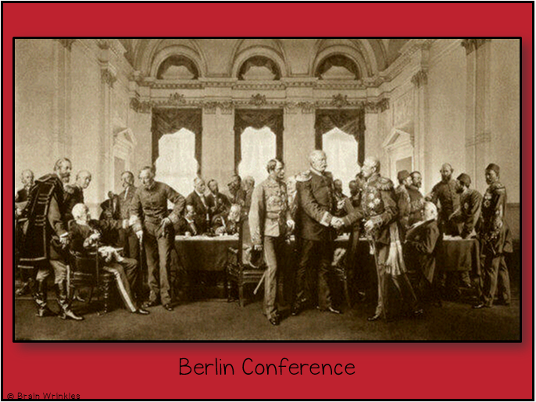
PARTIONING
PARTIONING
across
AFRICA
AFRICA
Presentation, Graphic Organizers, & Activities

Slide 2
STANDARDS:
SS7H1 Analyze continuity and change in Africa.
a. Explain how the European partitioning across Africa contributed to conflict, civil war, and artificial political boundaries in Africa today.
© Brain Wrinkles

Slide 3
TEACHER INFO: CLOZE Notes
The next pages are handouts for the students to use for note-taking during the presentation. (Print front to back to save paper and ink.)
Check the answers as a class after the presentation.
© Brain Wrinkles

Slide 4
Why Africa?
Europeans first became interested in Africa for __________________________ purposes.
They were looking for ways to __________________________ of the Arab and Ottoman empires in Southwest Asia.
Sailing around Africa was a long voyage and could not be completed __________________________ along the way.
Europeans created ports in southern and eastern Africa so traders could __________________________ before heading home.
Slave Trade
During the 16th century, Portuguese explorers became engaged in the __________________________ .
They kidnapped Africans and forced them to work on __________________________ in their colonies in the New World.
Other European countries __________________________ in the slave trade as well.
The trans-Atlantic slave trade lasted from the __________________________ .
Even after the slave trade had ended, European interest in Africa was __________________________ .
European countries saw that Africa was a continent full of __________________________ and mineral wealth.
Imperialism
The end of the 19th century is called the “Age of Imperialism” because that is when European countries __________________________ throughout Asia and Africa.
Imperialism is a system were a __________________________ and raw materials from another country.
A “strong” country was supposed to have __________________________ to increase its wealth and importance around the world.
Geographic Reasons
During this time, many European countries __________________________ by aggressively establishing colonies in Africa.
They wanted to __________________________ Africa’s resources (rubber, timber, diamonds, gold, etc.).
Europeans also wanted to protect their __________________________ .
© Brain Wrinkles
Partitioning Across Africa CLOZE Notes 1

Slide 5
Economic Reasons
__________________________ played a large part in the colonization of Africa.
The 19th century was a time of __________________________ in Europe (Industrial Revolution).
Factories __________________________ that could be manufactured into marketable products.
When Europeans returned to Africa for more resources, they brought back the manufactured goods and __________________________ .
Africa became a __________________________ for Europe to sell goods.
Political Reasons
__________________________ also led to the colonization of Africa.
Nationalism, a strong __________________________ in one's nation, resulted in competition between European nations.
No major nation wanted to be without colonies, which led to this __________________________
The competition was particularly fierce between Great Britain, France, and Germany, the __________________________ in the 1800s.
Religious Reasons
__________________________ gained strength during the 1800s as European countries were becoming more involved in Africa.
The idea of “Christianizing” Africa also made many Europeans __________________________ on the colonization of the continent.
Berlin Conference
By the 1880s, Great Britain, France, Germany, Belgium, Spain, and Portugal all wanted __________________________ .
To __________________________ over Africa, leaders from fourteen European governments and from the United States met in Berlin, Germany, in 1884.
__________________________ attended the meeting.
At the meeting, the European leaders discussed Africa’s land and how it __________________________ .
Going into the meeting, __________________________ of Africa was under European colonial rule.
By the end of the meeting, European powers __________________________ and drew boundary lines that remained until 1914.
__________________________ the most land in Africa and was “given” Nigeria, Egypt, Sudan, Kenya, and South Africa after defeating the Dutch Settlers and Zulu Nation.
The agreements made in Berlin still __________________________ of African countries today.
© Brain Wrinkles
Partitioning Across Africa CLOZE Notes 2

Slide 6
Artificial Boundaries
European powers organized Africa’s population in ways to make the _______________ , ignoring the natives’ cultural groups or existing political leadership.
Sometimes they __________________________ people who had never been united before.
Sometimes they __________________________ of people.
The creation of these borders had a negative impact on Africa’s __________________ by either dividing groups that wanted to be together or combining ethnic groups that were enemies.
European Control
Europeans placed colonies into __________________________ and forced the Africans to go along with their demands.
Europeans also tried to __________________________ by forcing them to give up their own African customs and adopt European ones.
Protests and revolts were common and __________________________ became widespread.
Europeans took the __________________________ .
African farmers were forced to grow cash crops like cocoa and coffee, causing there to be a __________________________ in many areas of Africa.
Africans were forced to work under __________________________ on plantations, railways, and logging.
Lasting Effects
In order to gain power, Europeans encouraged Africans to ______________________ .
New political boundaries caused __________________________ .
This has led to ethnic and political __________________________ .
There have been over __________________________ in Africa since WWII as a result of the colonial lines drawn by Europeans.
African Unrest
By the mid-twentieth century, Africans began to __________________________ European control of their countries.
It was obvious that colonialism __________________________ , as it only benefitted the Europeans.
Africans were tired of being treated like __________________________ on their own land.
They soon begin to __________________________ for themselves and the desire for independence spread across Africa.
Independence
After World War I, many African countries began to gain independence; however, they were __________________________ .
Tribal conflicts began to erupt and __________________________ over the artificially drawn European boundaries.
Post-colonization conflicts continued __________________________ .
© Brain Wrinkles
Partitioning Across Africa CLOZE Notes 3

Slide 7
Why Africa?
Europeans first became interested in Africa for trade route purposes.
They were looking for ways to avoid the taxes of the Arab and Ottoman empires in Southwest Asia.
Sailing around Africa was a long voyage and could not be completed without “pit stops” along the way.
Europeans created ports in southern and eastern Africa so traders could restock supplies before heading home.
Slave Trade
During the 16th century, Portuguese explorers became engaged in the African slave trade.
They kidnapped Africans and forced them to work on plantations and mines in their colonies in the New World.
Other European countries soon participated in the slave trade as well.
The trans-Atlantic slave trade lasted from the 1500s to the mid-1800s.
Even after the slave trade had ended, European interest in Africa was still going strong.
European countries saw that Africa was a continent full of vast natural resources and mineral wealth.
Imperialism
The end of the 19th century is called the “Age of Imperialism” because that is when European countries competed for land and power throughout Asia and Africa.
Imperialism is a system were a strong country takes wealth and raw materials from another country.
A “strong” country was supposed to have many colonies to increase its wealth and importance around the world.
Geographic Reasons
During this time, many European countries expanded their empires by aggressively establishing colonies in Africa.
They wanted to exploit and export Africa’s resources (rubber, timber, diamonds, gold, etc.).
Europeans also wanted to protect their trade routes.
© Brain Wrinkles
Partitioning Across Africa CLOZE Notes 1

Slide 8
Economic Reasons
Economic motivation played a large part in the colonization of Africa.
The 19th century was a time of great industrialization in Europe (Industrial Revolution).
Factories required raw materials that could be manufactured into marketable products.
When Europeans returned to Africa for more resources, they brought back the manufactured goods and sold them to Africans.
Africa became a new market for Europe to sell goods.
Political Reasons
Politics in Europe also led to the colonization of Africa.
Nationalism, a strong sense of pride in one's nation, resulted in competition between European nations.
No major nation wanted to be without colonies, which led to this “Scramble for Africa”.
The competition was particularly fierce between Great Britain, France, and Germany, the strongest European nations in the 1800s.
Religious Reasons
Christian missionary work gained strength during the 1800s as European countries were becoming more involved in Africa.
The idea of “Christianizing” Africa also made many Europeans look favorably on the colonization of the continent.
Berlin Conference
By the 1880s, Great Britain, France, Germany, Belgium, Spain, and Portugal all wanted part of Africa.
To prevent a European war over Africa, leaders from fourteen European governments and from the United States met in Berlin, Germany, in 1884.
No Africans attended the meeting.
At the meeting, the European leaders discussed Africa’s land and how it should be divided.
Going into the meeting, roughly 10% of Africa was under European colonial rule.
By the end of the meeting, European powers “owned” most of Africa and drew boundary lines that remained until 1914.
Great Britain won the most land in Africa and was “given” Nigeria, Egypt, Sudan, Kenya, and South Africa after defeating the Dutch Settlers and Zulu Nation.
The agreements made in Berlin still affect the boundaries of African countries today.
© Brain Wrinkles
Partitioning Across Africa CLOZE Notes 2

Slide 9
Artificial Boundaries
European powers organized Africa’s population in ways to make the most efficient workforce, ignoring the natives’ cultural groups or existing political leadership.
Sometimes they grouped together people who had never been united before.
Sometimes they divided existing groups of people.
The creation of these borders had a negative impact on Africa’s political and social structures by either dividing groups that wanted to be together or combining ethnic groups that were enemies.
European Control
Europeans placed colonies into administrative districts and forced the Africans to go along with their demands.
Europeans also tried to assimilate Africans by forcing them to give up their own African customs and adopt European ones.
Protests and revolts were common and starvation and disease became widespread.
Europeans took the best land by force.
African farmers were forced to grow cash crops like cocoa and coffee, causing there to be a shortage of food in many areas of Africa.
Africans were forced to work under terrible conditions on plantations, railways, and logging.
Lasting Effects
In order to gain power, Europeans encouraged Africans to fight against each other.
New political boundaries caused ethnic groups to clash.
This has led to ethnic and political unrest in Africa today.
There have been over 50 ethnic conflicts in Africa since WWII as a result of the colonial lines drawn by Europeans.
African Unrest
By the mid-twentieth century, Africans began to openly oppose European control of their countries.
It was obvious that colonialism was not fair, as it only benefitted the Europeans.
Africans were tired of being treated like second-class citizens on their own land.
They soon begin to demand freedom for themselves and the desire for independence spread across Africa.
Independence
After World War I, many African countries began to gain independence; however, they were not prepared for self-rule.
Tribal conflicts began to erupt and civil wars started over the artificially drawn European boundaries.
Post-colonization conflicts continued until almost 2000.
© Brain Wrinkles
Partitioning Across Africa CLOZE Notes 3

Slide 10
European Partitioning across
AFRICA
© Brain Wrinkles

Slide 11
Why Africa?
Europeans first became interested in Africa for trade route purposes.
They were looking for ways to avoid the taxes of the Arab and Ottoman empires in Southwest Asia.
Sailing around Africa was a long voyage and could not be completed without “pit stops” along the way.
Europeans created ports in southern and eastern Africa so traders could restock supplies before heading home.
© Brain Wrinkles

Slide 12
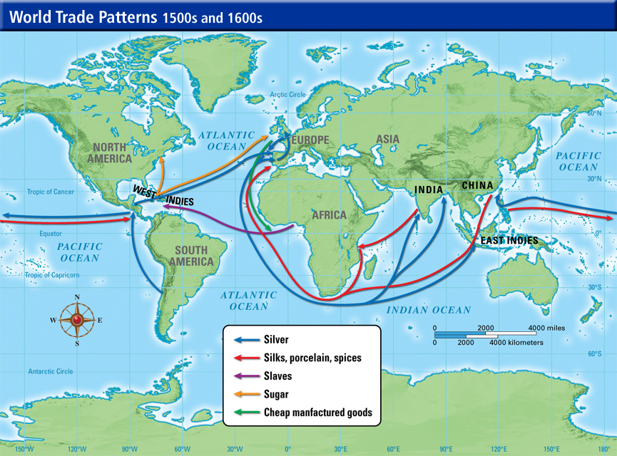
© Brain Wrinkles

Slide 13
Slave Trade
During the 16th century, Portuguese explorers became engaged in the African slave trade.
They kidnapped Africans and forced them to work on plantations and mines in their colonies in the New World.
Other European countries soon participated in the slave trade as well.
© Brain Wrinkles

Slide 14
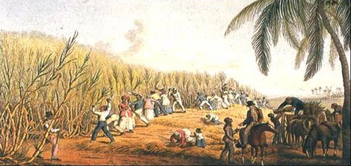
© Brain Wrinkles

Slide 15
Slave Trade
The trans-Atlantic slave trade lasted from the 1500s to the mid-1800s.
Even after the slave trade had ended, European interest in Africa was still going strong.
European countries saw that Africa was a continent full of vast natural resources and mineral wealth.
© Brain Wrinkles

Slide 16
Imperialism
The end of the 19th century is called the “Age of Imperialism” because that is when European countries competed for land and power throughout Asia and Africa.
Imperialism is a system where a strong country takes wealth and raw materials from another country.
A “strong” country was supposed to have many colonies to increase its wealth and importance around the world.
© Brain Wrinkles

Slide 17
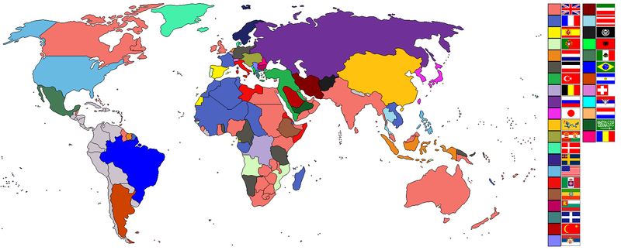
Age of Imperialism
© Brain Wrinkles

Slide 18
Geographic Reasons
During this time, many European countries expanded their empires by aggressively establishing colonies in Africa.
They wanted to exploit and export Africa’s resources (rubber, timber, diamonds, gold, etc.).
Europeans also wanted to protect their trade routes.
© Brain Wrinkles

Slide 19
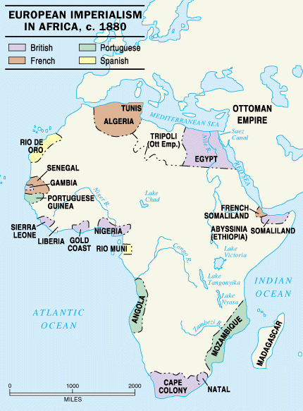
© Brain Wrinkles

Slide 20
Economic Reasons
Economic motivation played a large part in the colonization of Africa.
The 19th century was a time of great industrialization in Europe (Industrial Revolution).
Factories required raw materials that could be manufactured into marketable products.
© Brain Wrinkles

Slide 21
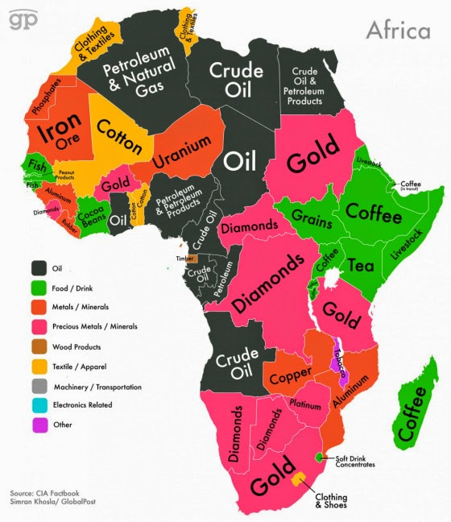
© Brain Wrinkles

Slide 22
Economic Reasons
When Europeans returned to Africa for more resources, they brought back the manufactured goods and sold them to Africans.
Africa became a new market for Europe to sell goods.
© Brain Wrinkles

Slide 23
Political Reasons
Politics in Europe also led to the colonization of Africa.
Nationalism, a strong sense of pride in one's nation, resulted in competition between European nations.
No major nation wanted to be without colonies, which led to this “Scramble for Africa”.
The competition was particularly fierce between Great Britain, France, and Germany, the strongest European nations in the 1800s.
© Brain Wrinkles

Slide 24
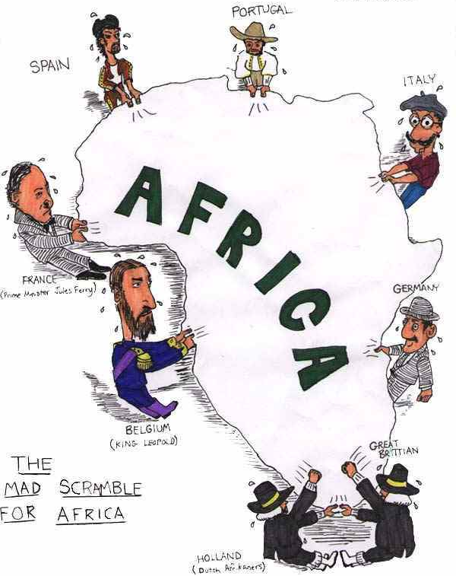
© Brain Wrinkles

Slide 25
Religious Reasons
Christian missionary work gained strength during the 1800s as European countries were becoming more involved in Africa.
The idea of “Christianizing” Africa also made many Europeans look favorably on the colonization of the continent.
© Brain Wrinkles

Slide 26
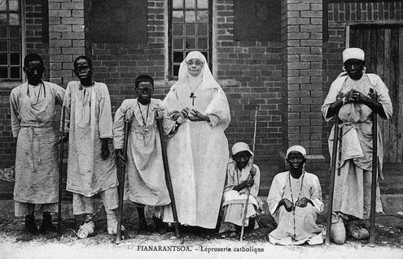
© Brain Wrinkles

Slide 27
Berlin Conference
By the 1880s, Great Britain, France, Germany, Belgium, Spain, and Portugal all wanted part of Africa.
To prevent a European war over Africa, leaders from fourteen European governments and from the United States met in Berlin, Germany, in 1884.
No Africans attended the meeting.
At the meeting, the European leaders discussed Africa’s land and how it should be divided.
© Brain Wrinkles

Slide 28
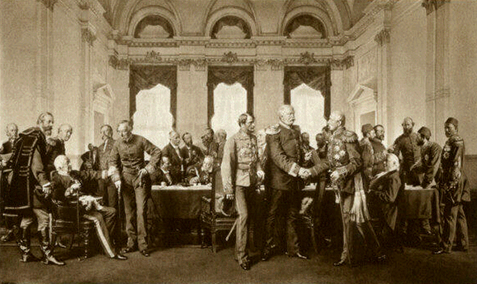
Berlin Conference
© Brain Wrinkles

Slide 29
Berlin Conference
Going into the meeting, roughly 10% of Africa was under European colonial rule.
By the end of the meeting, European powers “owned” most of Africa and drew boundary lines that remained until 1914.
Great Britain won the most land in Africa and was “given” Nigeria, Egypt, Sudan, Kenya, and South Africa after defeating the Dutch Settlers and Zulu Nation.
The agreements made in Berlin still affect the boundaries of African countries today.
© Brain Wrinkles

Slide 30
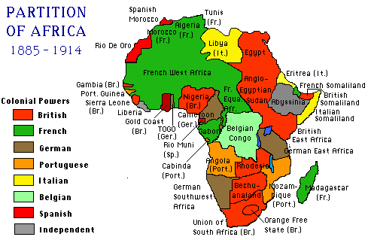
Political Boundaries after the Berlin Conference
© Brain Wrinkles

Slide 31
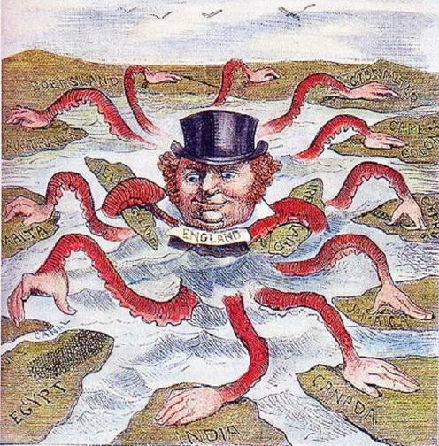
© Brain Wrinkles

Slide 32
Artificial Boundaries
European powers organized Africa’s population in ways to make the most efficient workforce, ignoring the natives’ cultural groups or existing political leadership.
Sometimes they grouped together people who had never been united before.
Sometimes they divided existing groups of people.
The creation of these borders had a negative impact on Africa’s political and social structures by either dividing groups that wanted to be together or combining ethnic groups that were enemies.
© Brain Wrinkles

Slide 33
European Control
Europeans placed colonies into administrative districts and forced the Africans to go along with their demands.
Europeans also tried to assimilate Africans by forcing them to give up their own African customs and adopt European ones.
Protests and revolts were common and starvation and disease became widespread.
© Brain Wrinkles

Slide 34
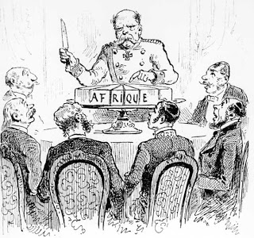
© Brain Wrinkles

Slide 35
European Control
Europeans took the best land by force.
African farmers were forced to grow cash crops like cocoa and coffee, causing there to be a shortage of food in many areas of Africa.
Africans were forced to work under terrible conditions on plantations, railways, and logging.
© Brain Wrinkles

Slide 36
Lasting Effects
In order to gain power, Europeans encouraged Africans to fight against each other.
New political boundaries caused ethnic groups to clash.
This has led to ethnic and political unrest in Africa today.
There have been over 50 ethnic conflicts in Africa since WWII as a result of the colonial lines drawn by Europeans.
© Brain Wrinkles

Slide 37
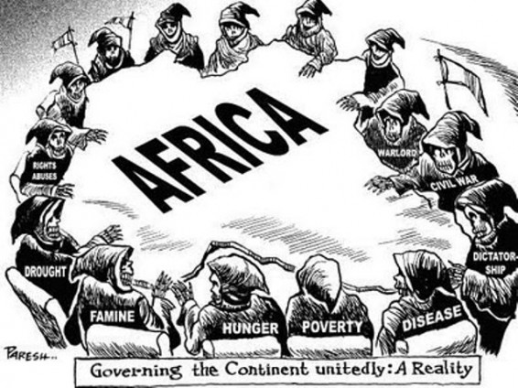
© Brain Wrinkles

Slide 38
African Unrest
By the mid-twentieth century, Africans began to openly oppose European control of their countries.
It was obvious that colonialism was not fair, as it only benefitted the Europeans.
Africans were tired of being treated like second-class citizens on their own land.
They soon begin to demand freedom for themselves and the desire for independence spread across Africa.
© Brain Wrinkles

Slide 39
Independence
After World War I, many African countries began to gain independence; however, they were not prepared for self-rule.
Tribal conflicts began to erupt and civil wars started over the artificially drawn European boundaries.
Post-colonization conflicts continued until almost 2000.
© Brain Wrinkles

Slide 40
TEACHER INFO: Partitioning of Africa Map
Print off the map for each student.
Have the students first create a color-coded key and then color the African countries with the colors of the European countries that colonized each one.
Check answers as a class to be sure that maps are completed correctly.
© Brain Wrinkles

Slide 41
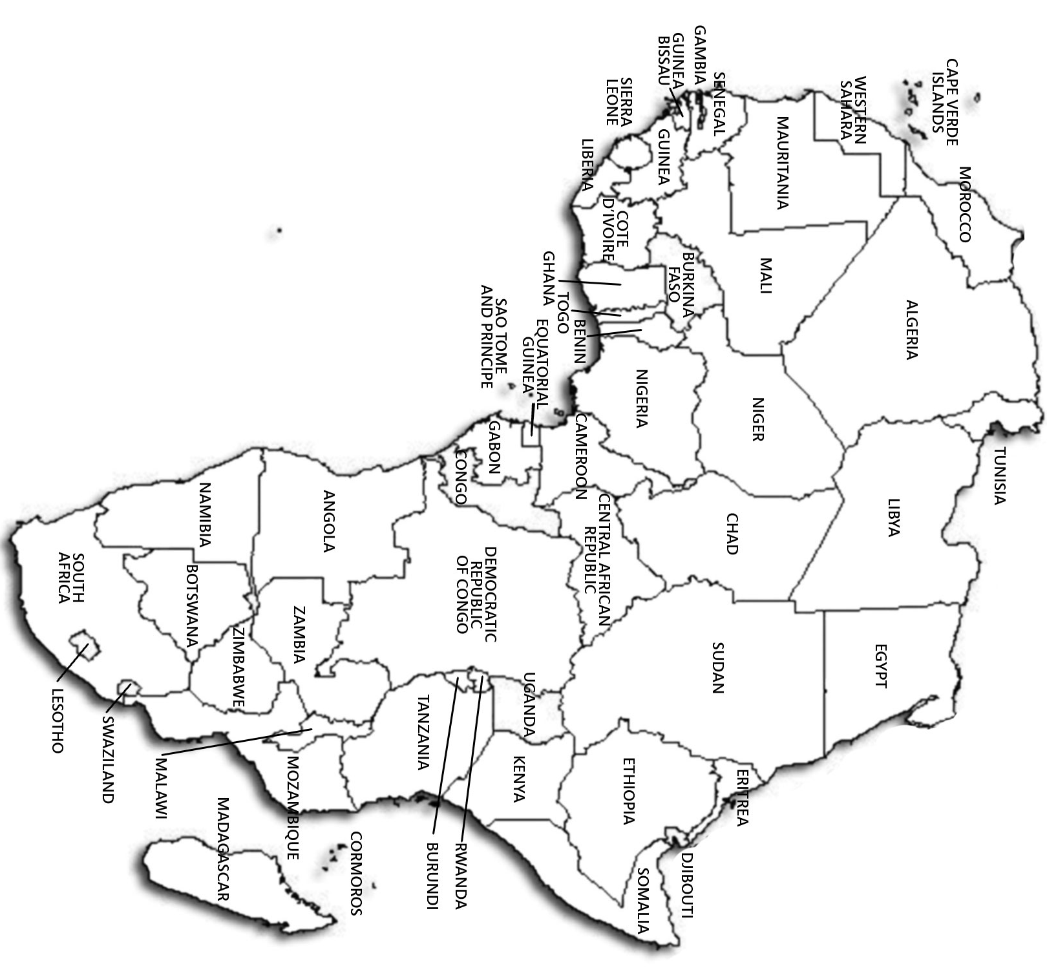
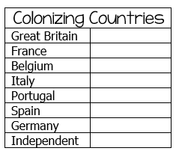
© Brain Wrinkles
Map Key
European Partitioning
Across Africa
Directions: Create a color-coded key for the Colonizing Countries. Next, color the countries below to correspond with the countries that colonized them.

Slide 42
© Brain Wrinkles

Slide 43
TEACHER INFO: Why Colonize? Foldable
Print off the Colonization foldable for each student.
The students will cut the template out along the thick, outside lines.
Next, they will cut along the thin lines that divide each word, stopping at the gray rectangle.
They should attach the side of the template (gray rectangle) to their notebooks.
They will now be able to open up each flap and write information about each cause of colonization underneath.
© Brain Wrinkles

Slide 44
Reasons for Colonizing Africa
© Brain Wrinkles
Religious
Political
Geographic
Economic

Slide 45
Reasons for Colonizing Africa (KEY)
© Brain Wrinkles
RELIGIOUS - Missionaries wanted to spread Christianity to native Africans | POLITICAL - Nationalism was strong in Europe, which resulted in competition between European countries. No country wanted to be without colonies (considered “weak”). | ECONOMIC - European countries wanted Africa’s vast raw materials (natural resources) to use to make products during the “Age of Industrialization”. Africa became a new market – people from European countries could sell their finished goods to Africans. | GEOGRAPHIC - European countries wanted new lands for places to build colonies. They also wanted to protect their trade routes.

Slide 46
TEACHER INFO: Imperialism YouTube Video
Have the students draw a scene from a movie (made-up) that captures an important event from the Age of Imperialism (empire building in Africa).
They should write a description of what’s happening in the scene, when it occurred (“published”), and a title of the movie.
They will also draw scenes from 4 related videos (other things that they learned about European empire building in Africa).
*Project the directions slide (red) onto the board so that the students know what goes in each section.
© Brain Wrinkles

Slide 47
SS
List key vocabulary terms that relate to the topic
Related Videos:
Draw a scene or symbol for 4 related videos. Write the title underneath each one.
Draw a screen capture of a video of an important event from the Age of Imperialism (specifically empire building in Africa).
Title:
Published:
Write a catchy title.
Date this occurred
Description:
Write a summary of the event.
Likes #
Dislikes #
__________
__________
© Brain Wrinkles

Slide 48
SS
Related Videos:
Title:
Published:
Description:
__________
__________
© Brain Wrinkles

Slide 49
TEACHER INFO: Citation for Injustice
Print off the Citation for Injustice handout for each student.
The students will write a “ticket” to a European imperialist (Offender) for his poor treatment of the Africans. They should describe how the European treated the Africans during this time period. Then, they will write how they think the European should have treated the Africans.
In the “polaroid picture”, they will draw a scene that shows the poor treatment of Africans by Europeans during the Scramble for Africa.
© Brain Wrinkles

Slide 50
A Citation
for Injustice
Ticket Number 67483928-22
Offender: Date:
Describe the Offense:
Instead, the lawbreaker should have:
Signature:
Photographic Evidence
© Brain Wrinkles

Slide 51
TEACHER INFO: Comprehension Check
Print off the Comprehension Check for each student.
After the lesson, have the students answer the questions. *This could also be used as a quiz.
© Brain Wrinkles

Slide 52
1. Why did Europeans first become interested in Africa?
2. Why is the end of the 19th century called the “Age of Imperialism”?
3. What was the purpose of the Berlin Conference?
4. What was the main goal of European countries when they divided Africa?
5. What was the result of the “scramble for Africa”?
6. Which European country gained the most land in Africa?
7. What did European countries fail to consider when making artificial political boundaries in Africa?
8. Did European countries care about maintaining African ethnic groups? Explain.
9. What was life like for Africans under European control?
10. By the mid-twentieth century, what spread through Africa?
11. Why did conflicts continue to erupt in many African countries even after they had gained independence?
© Brain Wrinkles
Empire Partitioning Across Africa
Comprehension Check

Slide 53
1. Why did Europeans first become interested in Africa?
Trade routes/trading purposes
2. Why is the end of the 19th century called the “Age of Imperialism”?
European countries aggressively expanded their empires in Asia and Africa
3. What was the purpose of the Berlin Conference?
To set up the partitioning of Africa (by Europeans) in order to avoid a European war
4. What was the main goal of European countries when they divided Africa?
To establish colonies in order to exploit and export Africa’s raw materials
5. What was the result of the “scramble for Africa”?
European nations took control of almost all African territory
6. Which European country gained the most land in Africa?
Great Britain
7. What did European countries fail to consider when making artificial political boundaries in Africa?
Differences in ethnic groups, cultures, and political traditions
8. Did European countries care about maintaining African ethnic groups? Explain.
No—they drew artificial boundaries to suit their own needs & didn’t take into consideration the groups that were living there
9. What was life like for Africans under European control?
Europeans tried to assimilate Africans; forced to grow cash crops which caused food shortages; forced to work under terrible conditions
10. By the mid-twentieth century, what spread through Africa?
A desire for independence from European control
11. Why did conflicts continue to erupt in many African countries even after they had gained independence?
Different tribes and ethnic groups still had resentments from being thrown together by Europeans
© Brain Wrinkles
Empire Partitioning Across Africa
Comprehension Check KEY

Slide 54
TEACHER INFO: Ticket Out the Door
Print off the Save It Ticket Out the Door for each student (two-per-page).
Have the students write down the most important thing that they want to remember (save) about European partitioning across Africa.
© Brain Wrinkles

Slide 55
Name:
Name:
Save It
Save It
Why was European partitioning across Africa so significant? What is the most important thing that you want to remember about it? “Save it” on the disk below.
Why was European partitioning across Africa so significant? What is the most important thing that you want to remember about it? “Save it” on the disk below.
© Brain Wrinkles
© Brain Wrinkles

Slide 56
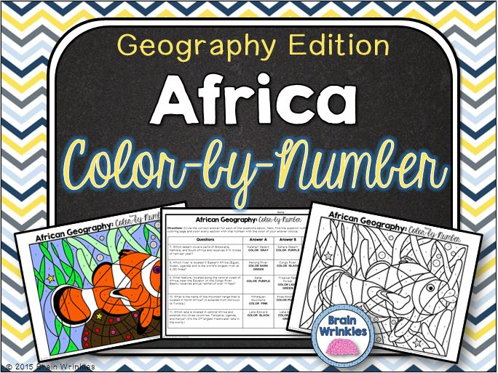
Thank You!
Thank you so much for downloading this file. I sincerely hope you find it helpful and that your students learn a lot from it! I look forward to reading your feedback in my store.
If you like this file, you might want to check out some of my other products that teach social studies topics in creative, engaging, and hands-on ways.
Best wishes,
Ansley at Brain Wrinkles

Slide 57
© Brain Wrinkles. Your download includes a limited use license from Brain Wrinkles. The purchaser may use the resource for personal classroom use only. The license is not transferable to another person. Other teachers should purchase their own license through my store.
This resource is not to be used:
By an entire grade level, school, or district without purchasing the proper number of licenses. For school/district licenses at a discount, please contact me.
As part of a product listed for sale or for free by another individual.
On shared databases.
Online in any way other than on password-protected website for student use only.
© Copyright Brain Wrinkles. All rights reserved. Permission is granted to copy pages specifically designed for student or teacher use by the original purchaser or licensee. The reproduction of any other part of this product is strictly prohibited. Copying any part of this product and placing it on the Internet in any form (even a personal/classroom website) is strictly forbidden. Doing so makes it possible for an Internet search to make the document available on the Internet, free of charge, and is a violation of the Digital Millennium Copyright Act (DMCA).
Thank you,
Ansley at Brain Wrinkles
Terms of Use
Clipart, fonts, & digital papers for this product were purchased from:

