Slide 1
HISTORY OF LATIN AMERICA: Recovery Slides
Use these slides to complete your recovery packet.

Slide 2
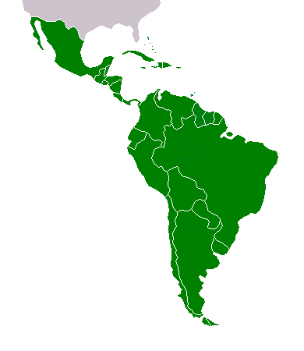
WHERE IS LATIN AMERICA?
All of South America, all of Central America, all of the islands in the Caribbean, and Mexico

Slide 3
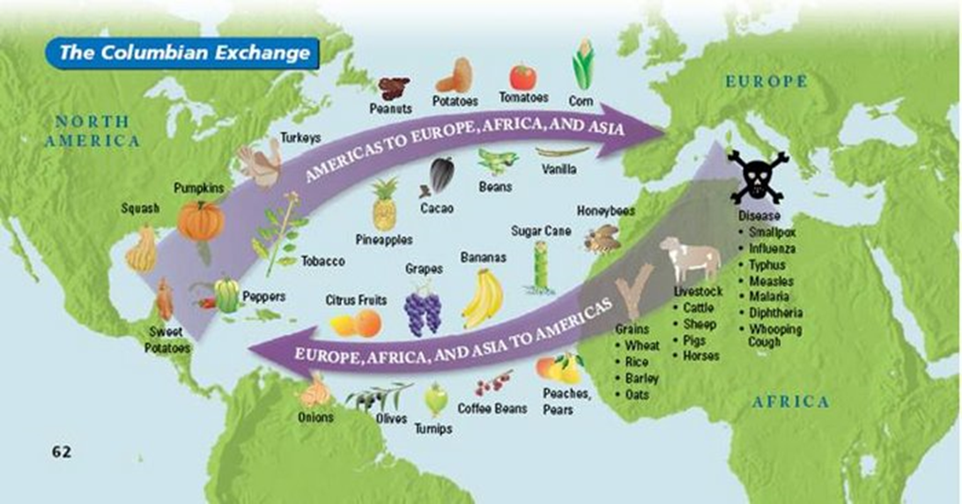
THE COLOMBIAN EXCHANGE
The movements of plants, animals, goods, people, diseases, and ideas between the Old World and the New World across the Atlantic Ocean.
The Colombian Exchange began in the 15th century.
Check out this YouTube video: https://www.youtube.com/watch?v=KVJv3EwbQqs

Slide 4
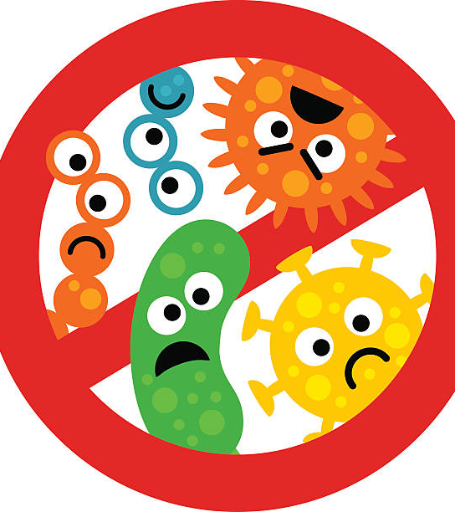
THE COLOMBIAN EXCHANGE: EFFECT ON NATIVE AMERICANS
Native Americans were used as the first slaves in Latin America.
Native Americans were easily defeated by Europeans because Europeans had advanced weapons and technology.
Additionally, many natives died due to diseases like measles, malaria, smallpox and typhus brought to the New World by Europeans. Native Americans had no immunities to these diseases.

Slide 5
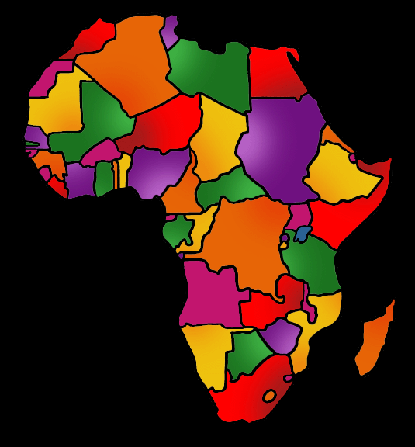
AFRICAN SLAVERY IN LATIN AMERICA
After enslaved native people died, Europeans began bringing slaves to the new world from West Africa.
Slaves were used in the farming and mining industries.
As a result of the Transatlantic Slave Trade, 80-90% of the population of Latin America was enslaved people.

Slide 6
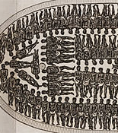
AFRICAN SLAVERY IN LATIN AMERICA
Conditions on ships transporting slaves were unsanitary.
25% of enslaved people died during the voyage to the New World.
Most slaves were sent to work in Brazil and the Caribbean Islands.

Slide 7
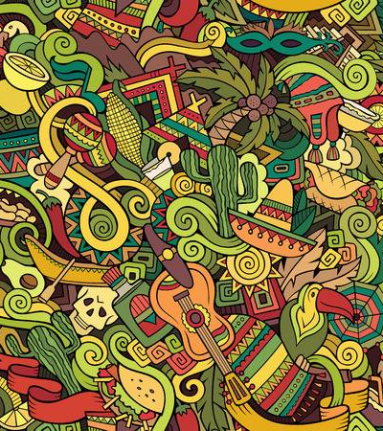
LATIN AMERICAN CULTURE: INFLUENCE BY EUROPEANS
Europeans brought new culture to the New World that is still prevalent today.
Primary Religion- Catholic Christianity
Primary Languages- Spanish and Portuguese
Brazil’s official language: Portuguese, because the area was colonized by explorers from Portugal.

Slide 8
LATIN AMERICAN CULTURE: INFLUENCE BY AFRICANS
Because of the history of slavery, many Latin American people have ancestors from Africa.
Intermarriage between Africans, Europeans, and Native Americans lead to new cultures being created.

Slide 9
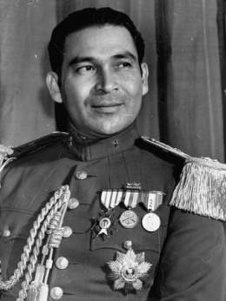
CUBA BEFORE THE CUBAN REVOLUTION
Before the Cuban Revolution, Cuba was lead by Fulgencio Batista.
Many Cubans were unhappy under Batista because of social and economic problems like poor healthcare, poor education, and high poverty levels.

Slide 10
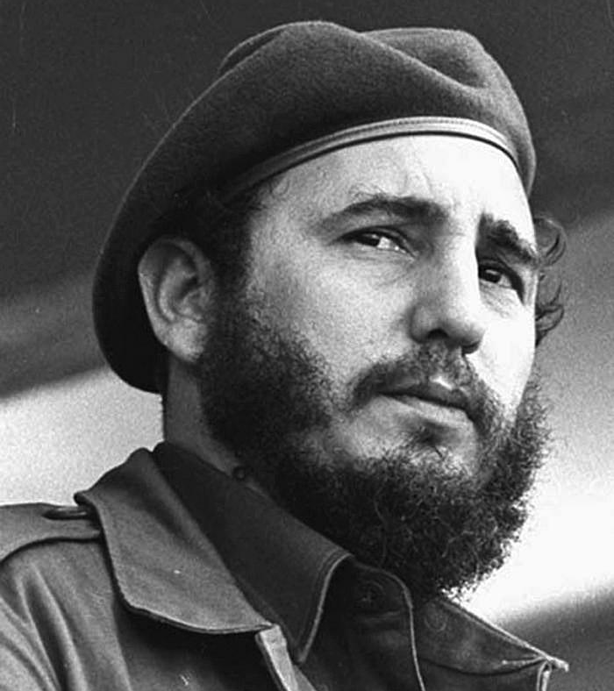
FIDEL CASTRO AND THE CUBAN REVOLUTION
In 1959, Fidel Castro overthrew Batista.
He made himself dictator of Cuba.
He made Cuba a communist country.

Slide 11
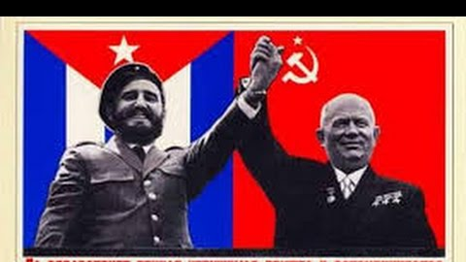
COMMUNIST CUBA
After Cuba became a communist country, many things got worse for citizens.
Castro’s communist government gave citizens less freedoms (no longer had right to protest). Churches closed and farms, factories, and businesses now all belonged to the government.
Also, the government controlled all news sources.

Slide 12
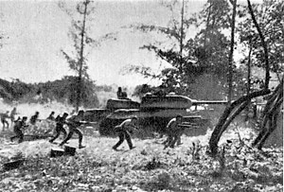
THE BAY OF PIGS
The CIA created a plan to arm exiled Cubans in Florida (with the help of unhappy Cuban citizens) to overthrow Castro in 1961.
The event was a huge disaster- plan was intercepted by Castro and invaders were captured.

Slide 13
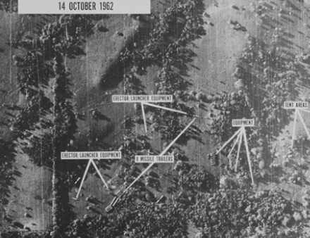
THE CUBAN MISSILE CRISIS
During the Cold War in 1962, US planes spotted a secret Soviet missile-launching base in Cuba that was a threat to the United States.
Check out this video https://www.youtube.com/watch?v=bwWW3sbk4EU

Slide 14
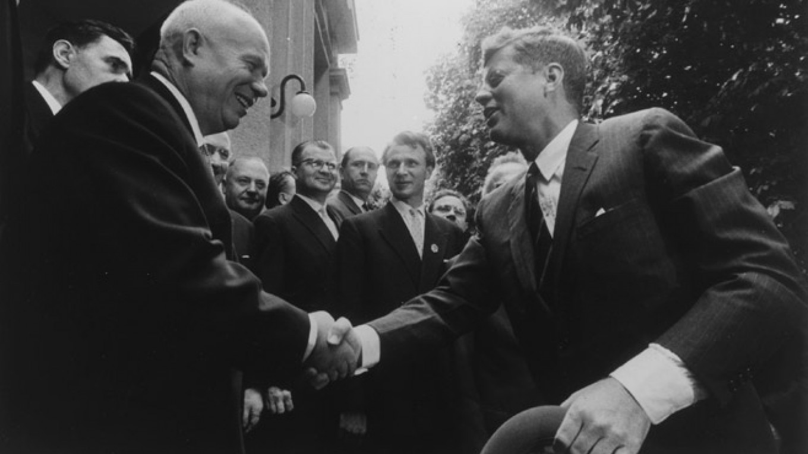
THE CUBAN MISSILE CRISIS- RESOLVED
Eventually, The US agreed not to invade Cuba and to removes its missiles from Turkey. The Soviet Union agreed to remove its missiles from Cuba.

Slide 15
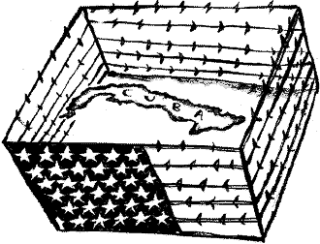
THE EMBARGO
As a result of tensions with Cuba, the US placed an EMBARGO on all Cuban imports.
An EMBARGO is a full stop to all trade.
The EMBARGO was intended to hurt Cuba’s economy and put political pressure on them to change their communist government.

Slide 16
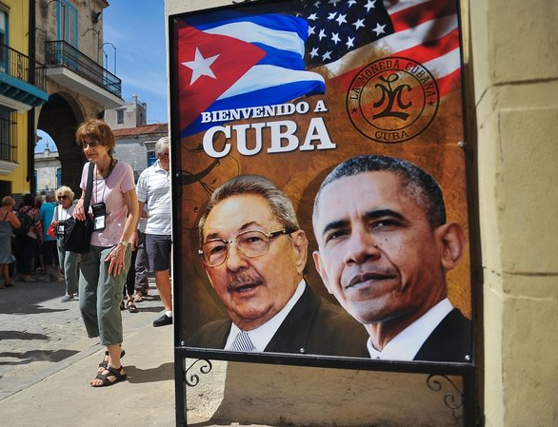
US-CUBA RELATIONS
The United States and Cuba’s relationship has improved in recent years.
2009: The US removed obstacles for family travel to Cuba from the US.
2015: The US and Cuba reopened embassies in each other's capital capitals.
2016: The US eased trade restrictions with Cuba.

Slide 17
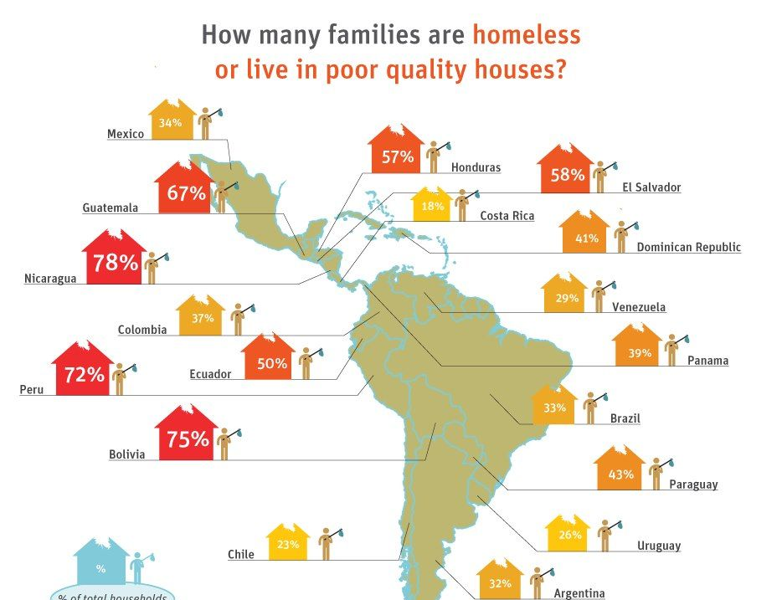
MODERN ISSUES IN LATIN AMERICA
Three of the biggest issues facing Latin American countries today are:
Poverty
Dictators
Drug Cartels
Because of these issues, many people immigrate to other areas of the world in search of a better life.

Slide 18
Literacy Rate and Poverty Rate
Literacy rate means the amount of people in a country who can read and write.
Poverty rate means the amount of people in a country who struggle to provide basic necessities- food, clothing, shelter.
When poverty rate is high, literacy rate tends to be low.

