Slide 1
PAN-AFRICAN
Movement
© Brain Wrinkles

Slide 2
Colonization
By the 20th century, European powers had colonized the majority of Africa.
The only independent countries were Liberia and Ethiopia.
Liberia was founded in 1822 by former American slaves.
© Brain Wrinkles

Slide 3
Nationalism
Africans resented their unequal status and lack of political rights under European control.
They wanted to take control of their own governments, land, and resources.
Nationalism, a feeling of strong pride in one’s own country, began to sweep across Africa and fed the desire for independence from European rule.
© Brain Wrinkles

Slide 4
Pan-African
An example of African nationalism was the Pan-African movement that began in the late 1800s.
The movement believed that all Africans shared a common heritage and should work together for their freedom.
The Pan-African movement’s principles actually dated back to the slave trade era.
The first Pan-African Congress occurred in 1900.
© Brain Wrinkles

Slide 5
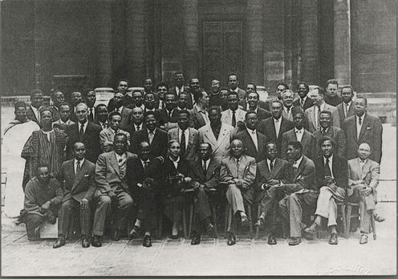
Pan-African Congress Delegates
© Brain Wrinkles

Slide 6
Pan-African
By the end of World War II, four more meetings had occurred.
The fifth Pan-African Congress counted in 90 delegates, including the future leaders of Kenya and Ghana.
Eventually, the influence of the movement began to fade, but not before pushing the cause of nationalism forward.
© Brain Wrinkles

Slide 7
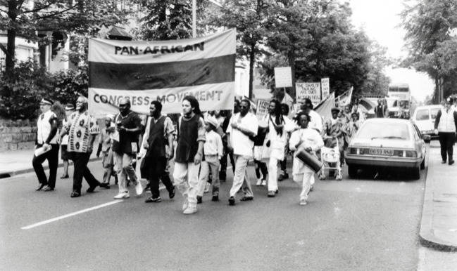
© Brain Wrinkles

Slide 8
Changes
Africa began to change by the 1940s.
The rule of tribal chiefs had weakened because of their links with colonial governments, thus limiting their ability to control people.
An educated middle class that disliked colonial life began to grow in the cities.
© Brain Wrinkles

Slide 9
Unrest
The cost for European countries to maintain colonies was rising.
By the second half of the century, unrest arose throughout the continent and African nations fought to free themselves from European control.
© Brain Wrinkles

Slide 10
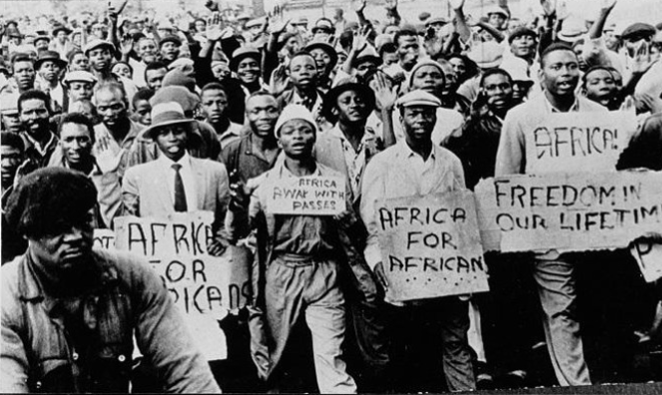
© Brain Wrinkles

Slide 11
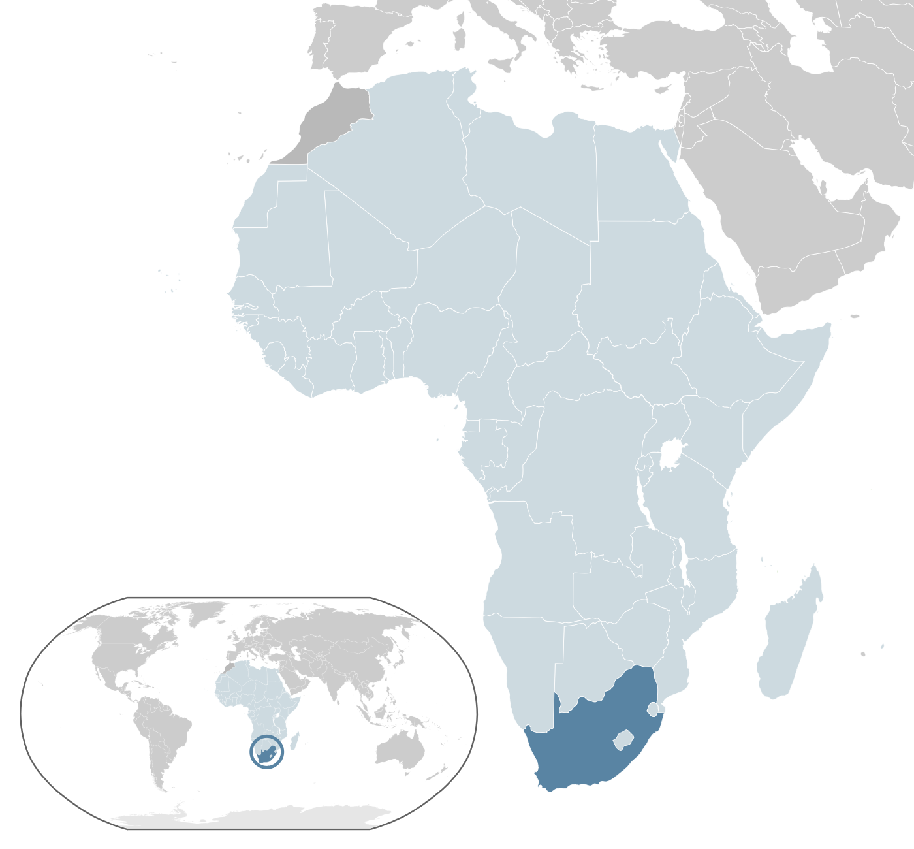
Republic of South Africa
© Brain Wrinkles

Slide 12
Colonization
In the 1600s, the British and the Dutch colonized South Africa.
South Africa was eventually seized by the British from the Dutch settlers (after the Boer War).
In 1685, the first policy of white superiority became visible when a law was passed forbidding whites and Africans to marry in the territory.
© Brain Wrinkles

Slide 13
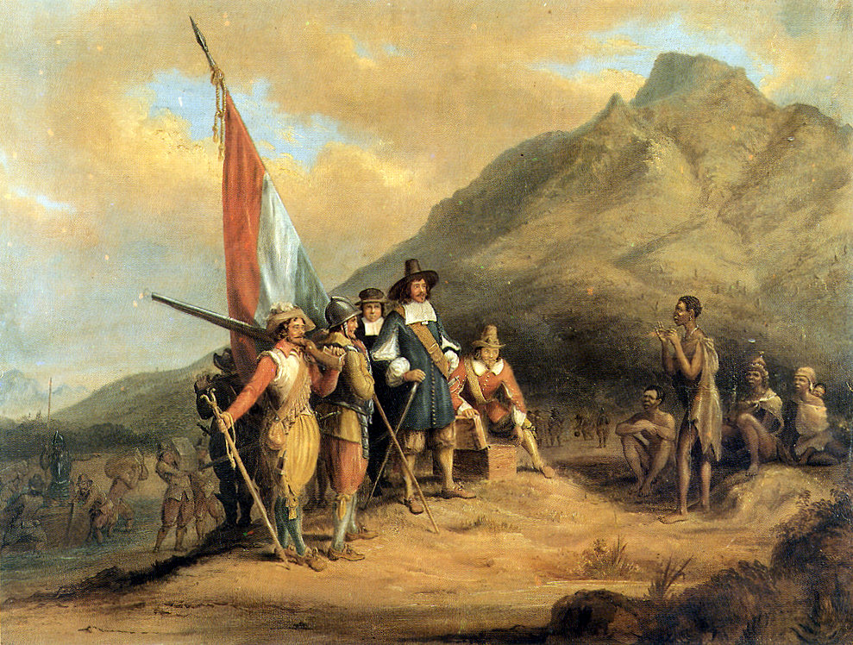
The arrival of the first European settlers -- Jan van Riebeeck (Dutch East India Company) in Table Bay in April 1652.
© Brain Wrinkles

Slide 14
Power
More European settlers came to South Africa than to anywhere else on the continent.
In 1910, Great Britain established the Union of South Africa.
Governing power was only given to whites.
In 1948, a new political party, the National Party, came to power and voted to implement a series of restrictive segregationist laws, known collectively as apartheid.
© Brain Wrinkles

Slide 15
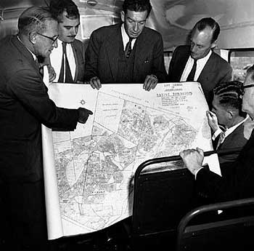
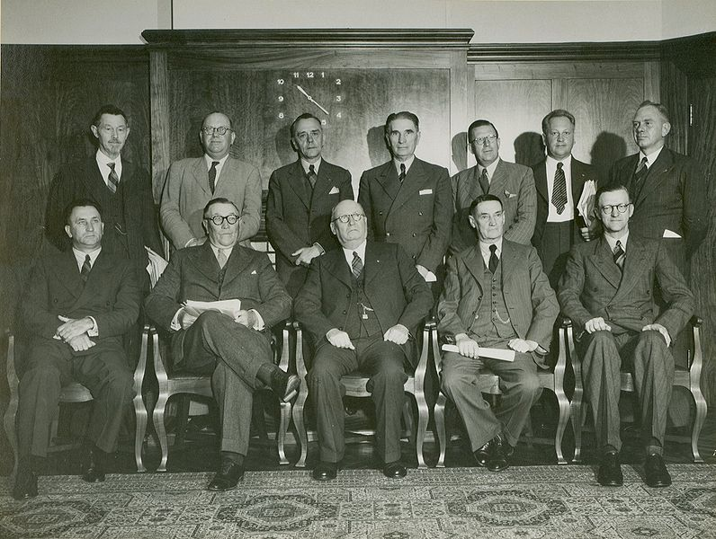
National Party 1948
© Brain Wrinkles

Slide 16
Apartheid
The National Party enforced the policy of apartheid through legislation across South Africa.
Apartheid was a social and political policy of racial segregation and discrimination.
In Afrikaans (the language of white South Africans), apartheid means “apartness”.
© Brain Wrinkles

Slide 17
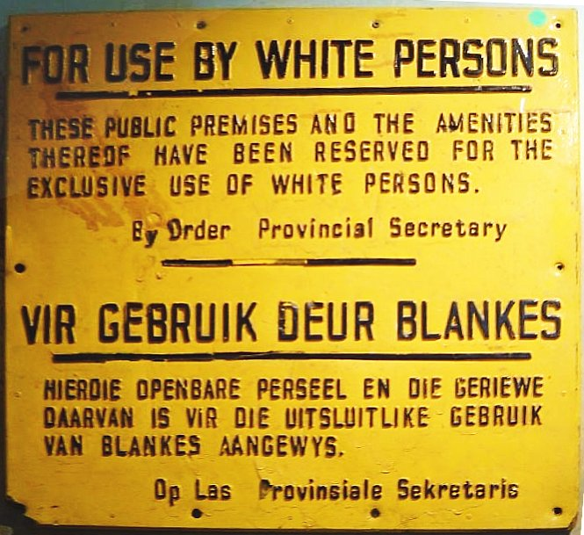
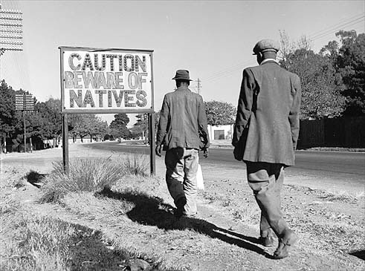
South African Signs
During the Apartheid Era
© Brain Wrinkles

Slide 18
Segregation
The policy of apartheid took a strong hold in the country.
It separated South Africa into whites and non-whites, restricting where blacks could live, work, travel, sit, go to the bathroom, eat, etc.
Under apartheid, blacks could not vote or participate in government.
What does this remind you of??
© Brain Wrinkles

Slide 19
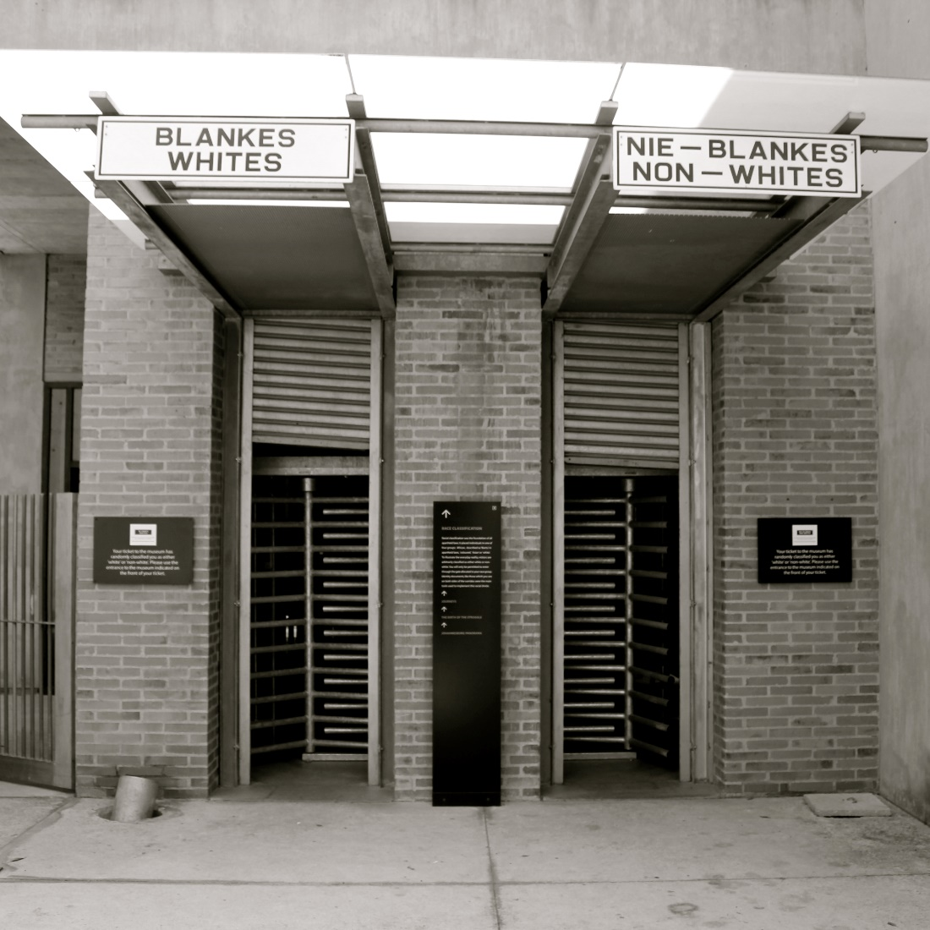
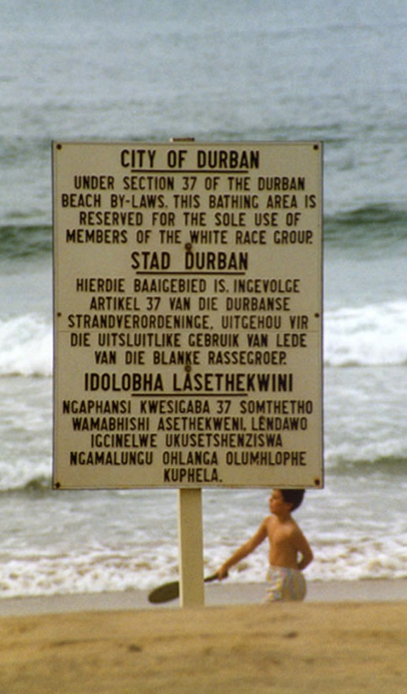
© Brain Wrinkles

Slide 20
Bantu Authorities Act
In 1951, government officials created the Bantu Authorities Act, which created “homelands” for black South Africans.
At this time, whites owned 80% of the land, although they only represented 10% of the population.
As a result of this law, 9 million South Africans were excluded from participating in the government.
© Brain Wrinkles

Slide 21
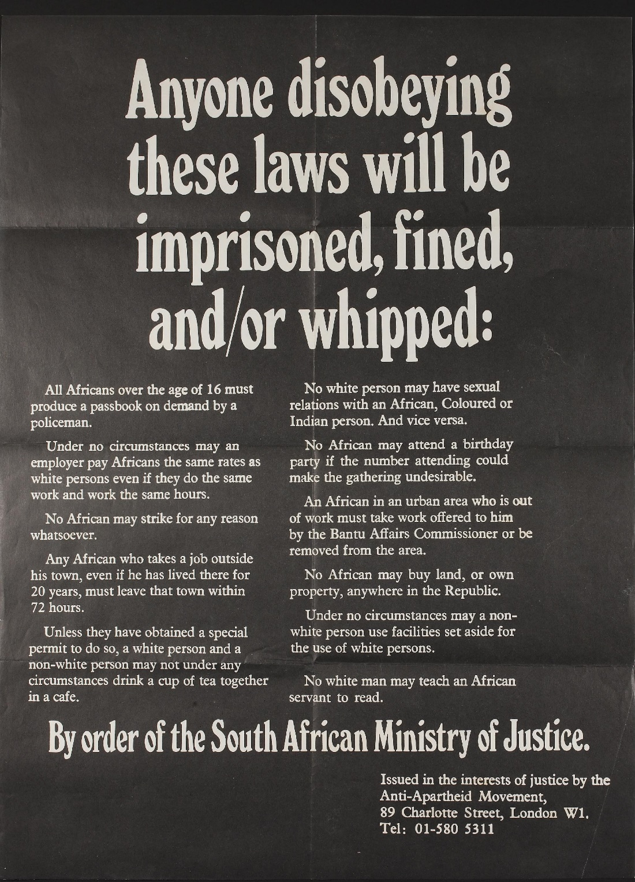
© Brain Wrinkles

Slide 22
Life Under Apartheid
Apartheid allowed many whites to grow wealthy and powerful, while millions of blacks suffered.
Afrikaners lived in up-scale neighborhoods while native South Africans lived in slums or in Bantustans.
© Brain Wrinkles

Slide 23
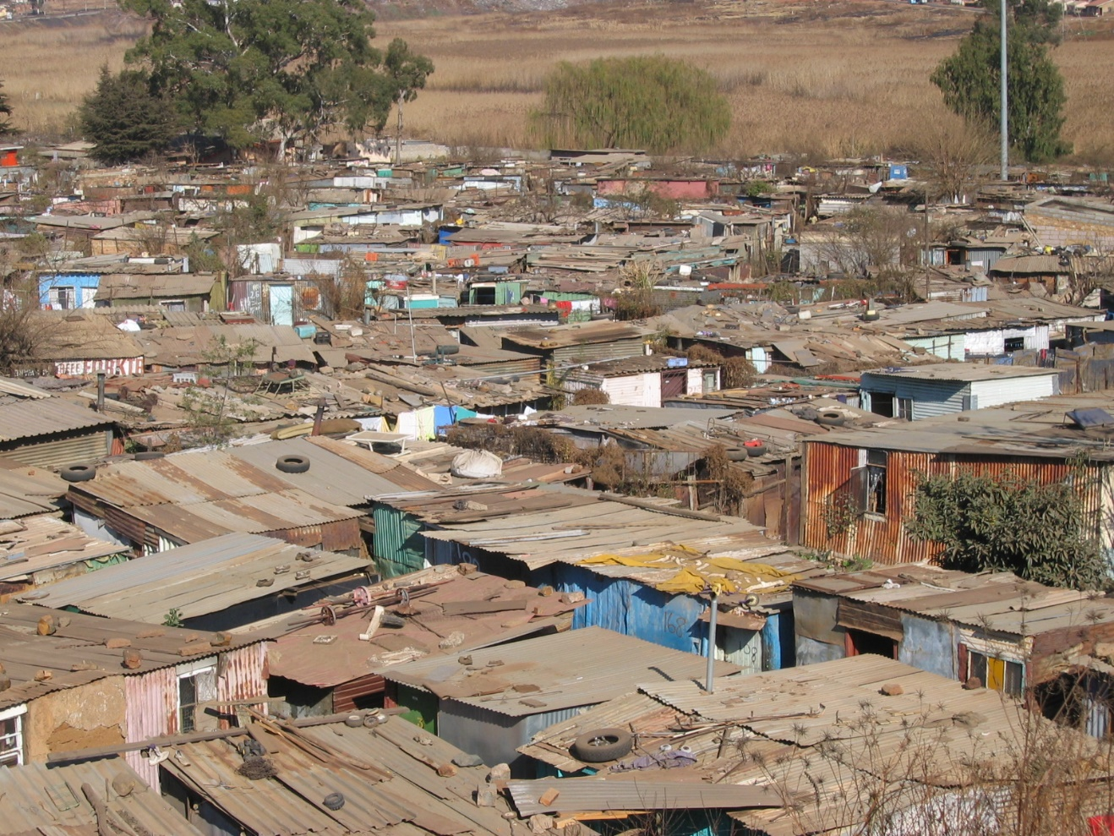
© Brain Wrinkles

Slide 24
Life Under Apartheid
Bantustans were artificially created reservations (“homelands”) for native Africans to live on.
Bantustans offered a poor quality of land and were unfit for the large populations forced to live there.
South Africans were unable to leave their Bantustan without a passport.
© Brain Wrinkles

Slide 25
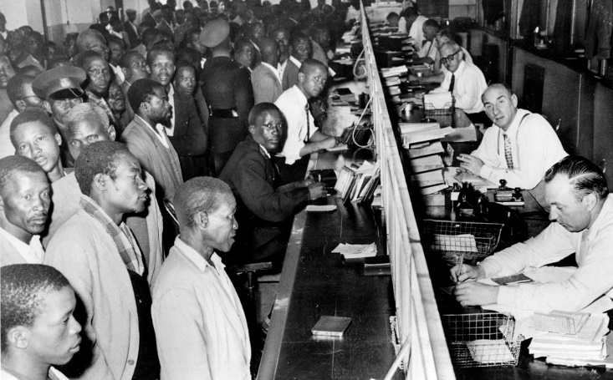
Black South Africans line up at the counter of a government office to get their new passbooks in Johannesburg, South Africa, April 7, 1960.
© Brain Wrinkles

Slide 26
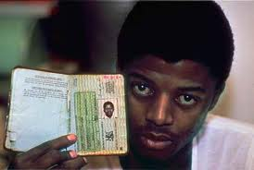
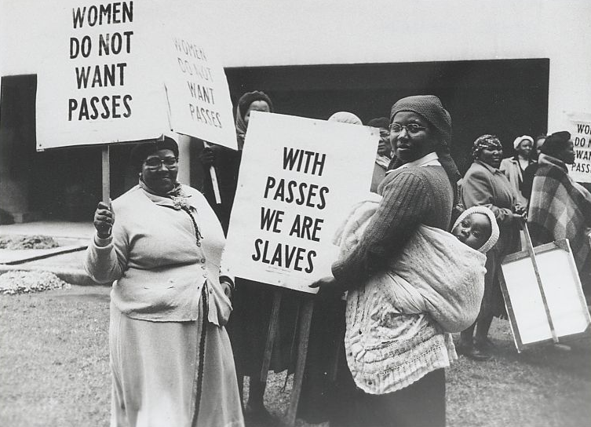
© Brain Wrinkles

Slide 27
A.N.C.
In the 1950s, the African National Congress, or ANC, began to actively fight apartheid.
The goal of the ANC was to increase rights of native Africans, although the group had no real power in government.
Eventually, the ANC was declared illegal by the South African government and members were often arrested.
© Brain Wrinkles

Slide 28
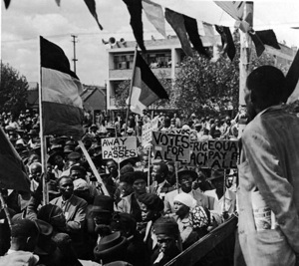
© Brain Wrinkles

Slide 29
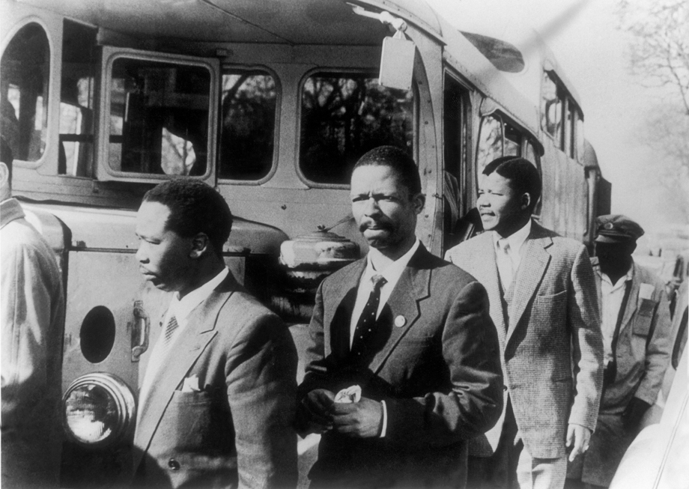
ANC Members
(Nelson Mandela, second from right)
© Brain Wrinkles

Slide 30
Mandela
Rolihlahla Mandela was born on July 18, 1918 in South Africa.
He was a member of the Thimbu tribe, and his father was chief of the city of Mvezo.
His father died when he was 9, and he was sent to live with a tribal chief who took care of his education.
On his first day of school, his teacher gave him the name of Nelson.
© Brain Wrinkles

Slide 31
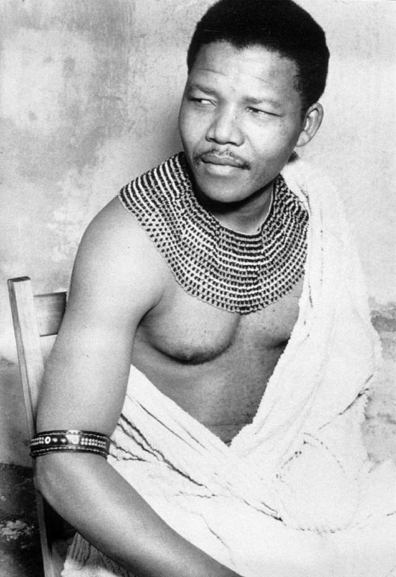
Rolihlahla “Nelson” Mandela
A Member of the Thimbu Tribe
© Brain Wrinkles

Slide 32
Mandela
Even though he was the first person in his family to attend school, he was an excellent student.
After graduating college, he became a lawyer and opened the South Africa’s first black law firm
Mandela wanted to defend poor, black South Africans charged with breaking apartheid laws.
© Brain Wrinkles

Slide 33
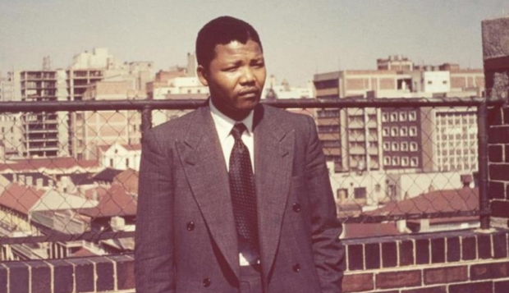
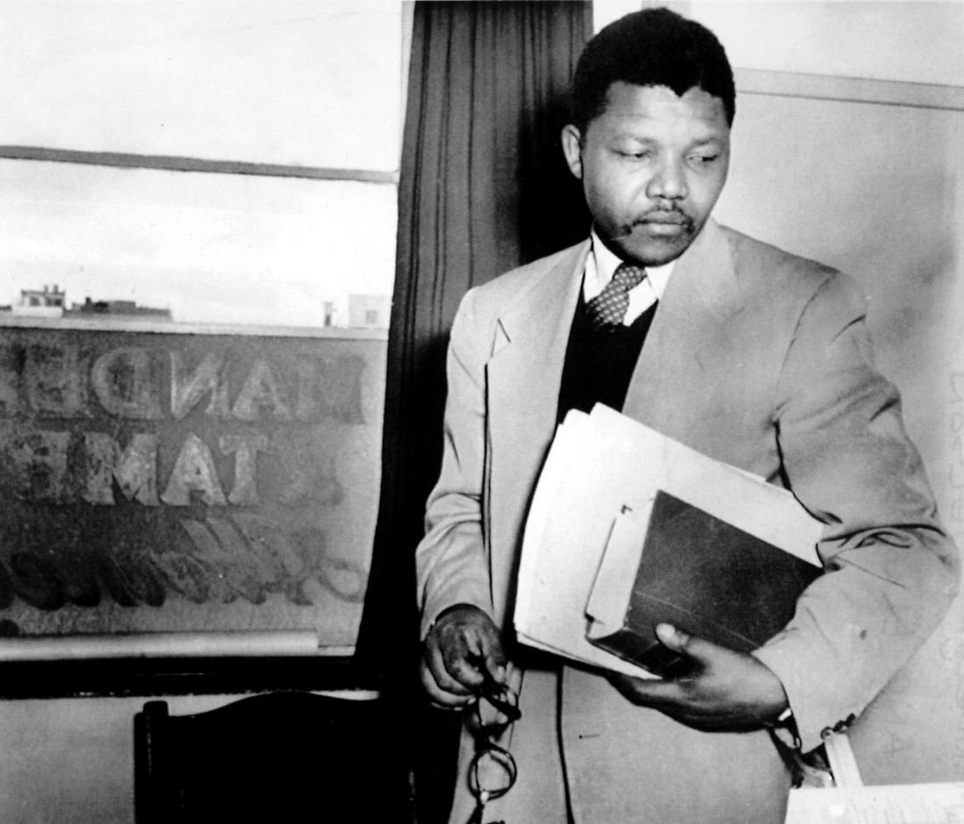
© Brain Wrinkles

Slide 34
Non-Violence
Mandela became a prominent member of the African National Congress and participated in numerous ANC-led protests against apartheid.
Nelson Mandela admired Gandhi, who had used peaceful protests in India.
He urged the ANC members to follow Gandhi’s beliefs in non-violent protests.
© Brain Wrinkles

