Slide 1
Important people and placesin se Asian history
2019

Slide 2
MAO ZEDONG
A YOUNG TEACHER WHO LED THE COMMUNIST TAKE OVER OF CHINA.
LED CHINA FROM 1949-1976
WANTED CHINA TO CONSIST OF FARMERS AND WORKS ALL WHO WOULD BE EQUAL.
This Photo by Unknown Author is licensed under CC BY-NC

Slide 3
MOHANDAS K. GANDHI
INDIAN POLITICAL LEADER WHO USED CIVIL DISOBEDIENCE TO HELP INDIA BECOME FREE OF BRITISH COLONIAL RULE.
This Photo by Unknown Author is licensed under CC BY-NC-ND
This Photo by Unknown Author is licensed under CC BY-NC-ND

Slide 4
MUHAMMAD ALI JINNAH
MUSLIM NATIONALIST WHO HELPED ESTABLISH PAKISTAN FROM THE BRITSIH CONTOL OF INDIA.
BECAME THE FIRST GOVERNOR GENERAL OF PAKISTAN
This Photo by Unknown Author is licensed under CC BY-SA

Slide 5
Jawaharlal Nehru
This Photo by Unknown Author is licensed under CC BY-NC-ND
FIRST INDIAN PRIME MINISTER AFTER INDEPENENCE FROM GREAT BRITIAN.

Slide 6
HARRY TRUMAN
U.S. PRESIDENT THAT ENDED WWII.
DEVELOPED U.S. POLICY OF CONTAINMENT.
This Photo by Unknown Author is licensed under CC BY-SA

Slide 7
EMPEROR HIROHITO
LAST RULING EMPEROR OF JAPAN.
RULED DURING WWII.
This Photo by Unknown Author is licensed under CC BY-SA

Slide 8
GENERAL DOUGLAS MACARTHUR
COMMANDER OF THE U.S. OCCUPATION OF JAPAN.
WROTE CONSTITUTION FOR JAPAN THAT MADE IT A CONSTITUTIONAL MONARCHY WITH A EMPEROR (FIGURE HEAD)
COMMANDER IN KOREAN WAR UNTIL REMOVED BY TRUMAN.
This Photo by Unknown Author is licensed under CC BY-SA

Slide 9
KIM IL-SUNG
FIRST COMMUNIST LEADER OF NORTH KOREA
This Photo by Unknown Author is licensed under CC BY-SA

Slide 10
JOHN F. KENNEDY
This Photo by Unknown Author is licensed under CC BY
U.S. PRESIDENT THAT BEGINS U.S. INVOLVEMENT IN VIETNAM OFFICALLY IN 1961,

Slide 11
RICHARD NIXON
U.S. PRESIDENT THAT EVENTUALLY GOT U.S. TROOPS OUT OF VIETNAM.
U.S. WITHDREW AND THE COUNTRY FELL TO COMMUNISM.
This Photo by Unknown Author is licensed under CC BY-SA-NC

Slide 12
Ho chi minh
LEADER OF THE NORTH VIETNAMESE AND SUPPORTED BY THE SOVIET UNION TO BRING COMMUNISM AND UNITE ALL OF VIETNAM.
This Photo by Unknown Author is licensed under CC BY-NC-ND

Slide 13
GEORGE H. W. BUSH
This Photo by Unknown Author is licensed under CC BY-NC
U.S. PRESIDENT AT THE END OF THE COLD WAR.

Slide 14
French indochina
VIETNAM, LAOS, CAMBODIA
This Photo by Unknown Author is licensed under CC BY-SA

Slide 15
TIANAMEN SQUARE (CHINA)
1989—STUDENT PROTESTS LED TO A HUGE DEMONSTRATION IN BEIJING.
GATHERED TO PROTEST WHAT THEY FELT WAS CORRUPTION IN GOV’T.
SOLDIERS BROKE UP PROTEST-FIRING ON STUDENTS; ARRESTING THOUSANDS.
This Photo by Unknown Author is licensed under CC BY-NC-ND

Slide 16
AMRISTAR
BRITISH AUTHORITIES OPENED FIRE ON A LARGE GATHERING OF PEACEFUL, UNARMED INDIANS CLAIMING THEY WERE GATERNING ILLEGALLY.
KILLED 400 POPLE AND WOUNDED 1200.
This Photo by Unknown Author is licensed under CC BY-SA-NC

Slide 17
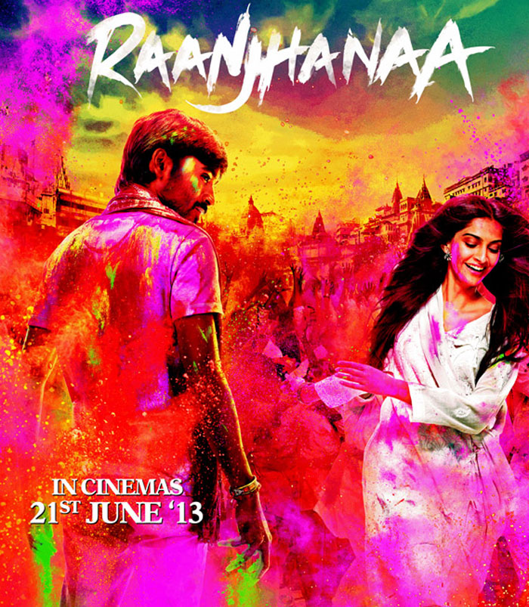
BOLLYWOOD
This Photo by Unknown Author is licensed under CC BY-SA
A PHRASE USED TO DESCRIBE MOVIES MADE IN MUMBAI (FORMERLY BOMBAY) USING HINDI LANGUAGE
This Photo by Unknown Author is licensed under CC BY-NC-ND

Slide 18
HIROSHIMA AND NAGASAKI JAPAN
This Photo by Unknown Author is licensed under CC BY-NC-ND
FIRST AND SECOND CITIES ATOMIC BOMBS WERE DROPPED ENDING WWII.

