Slide 1
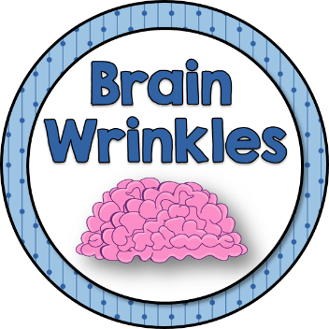
Rebuilding
JAPAN
© Brain Wrinkles

Slide 2
EMPIRE
Building
© Brain Wrinkles

Slide 3
An Empire
Japan forcefully created an empire with military strength throughout the early 1900s.
Japan captured Asian regions like Taiwan and Korea.
It invaded China and took Manchuria and other coastal cities.
Japan planned on taking over even more of the Pacific when it joined the Axis Powers during World War II.
© Brain Wrinkles

Slide 4
Pearl Harbor
On December 7, 1941, Japanese airplanes made a surprise attack on the US naval base at Pearl Harbor in Hawaii.
More than 2,400 people were killed, and many US battleships and airplanes were destroyed.
© Brain Wrinkles

Slide 5
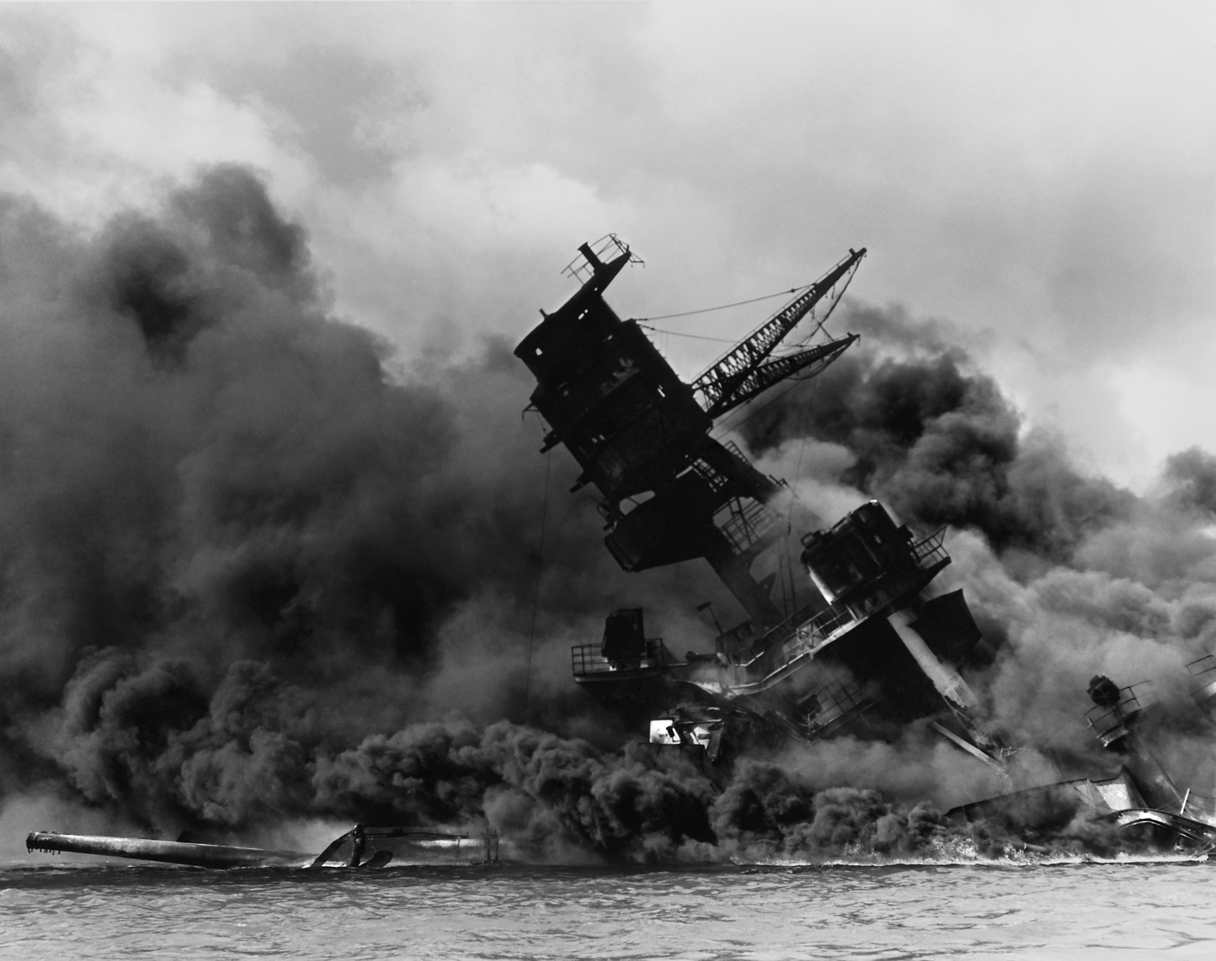
The USS Arizona after the Japanese surprise attack on Pearl Harbor.
© Brain Wrinkles

Slide 6
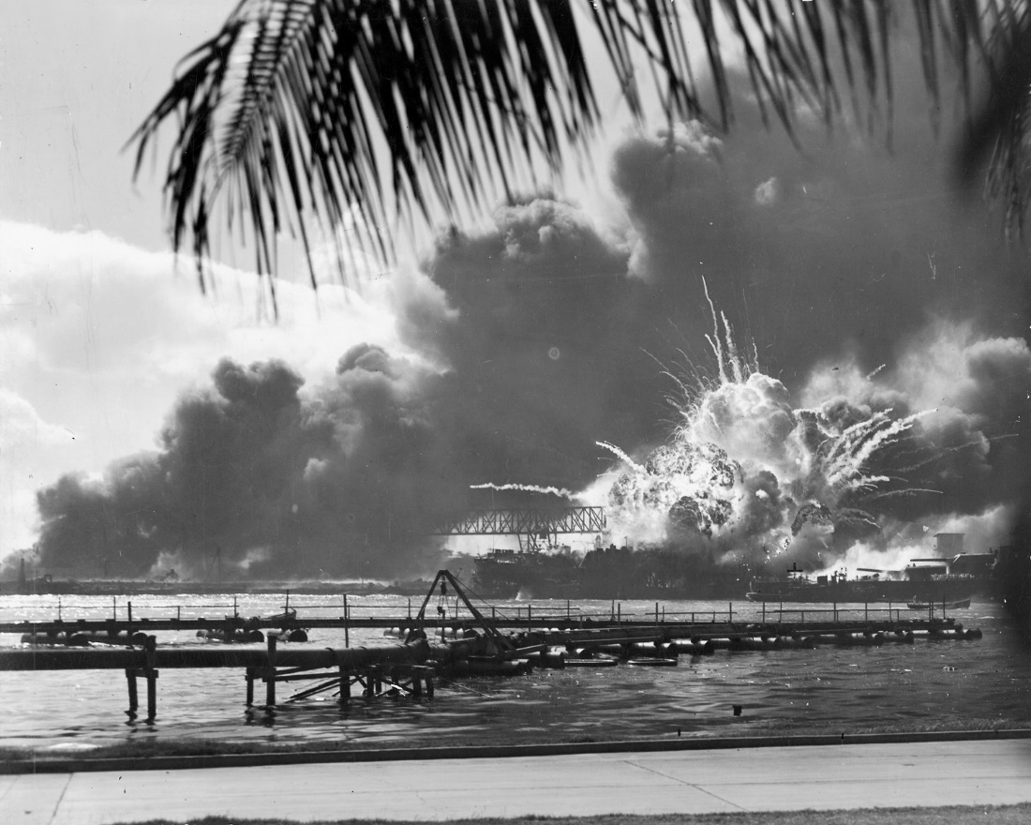
President Roosevelt called December 7, 1941, “a day that will live in infamy.”
© Brain Wrinkles

Slide 7
US Enters WWII
The next day, President Roosevelt asked Congress to declare war on Japan.
They agreed and the US officially entered WWII on December 8, 1941.
On December 11, Germany and Italy declared war on the US.
The US was now deeply involved in WWII on the side of the Allies.
© Brain Wrinkles

Slide 8
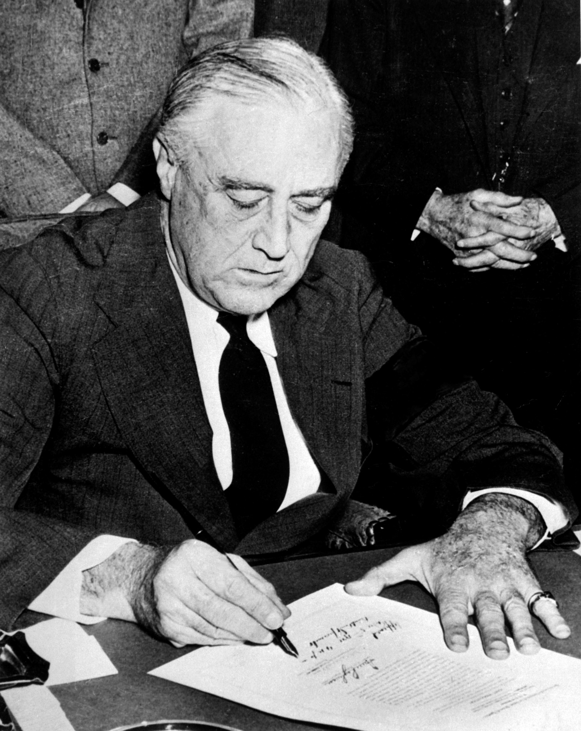
President Roosevelt Signing Declaration of War Against Japan.
© Brain Wrinkles

Slide 9
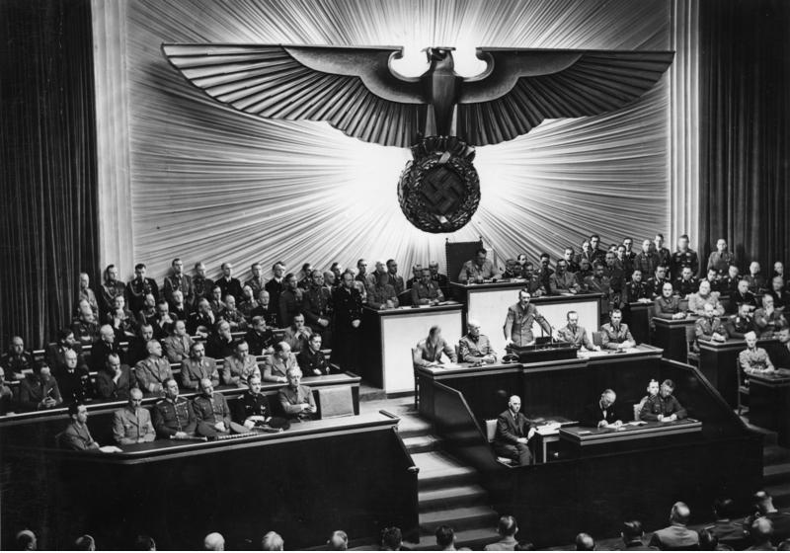
Hitler Declares War on the US – 1941.
© Brain Wrinkles

Slide 10
Island Hopping
In 1944, the US followed an “island-hopping” campaign in the Pacific.
US forces attacked island after island held by the Japanese.
This campaign brought American troops closer and closer to Japan.
© Brain Wrinkles

Slide 11
Kamikazes
Fighting Japan was difficult because the Japanese were fierce warriors.
The Japanese soldiers never gave up and were willing to sacrifice themselves for their country.
Japanese kamikaze pilots crashed their planes into US ships on purpose, fully expecting to die.
© Brain Wrinkles

Slide 12
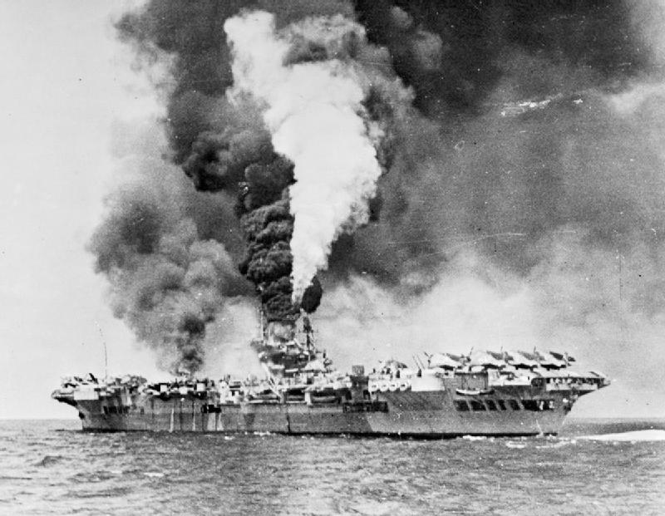
An Aircraft Carrier Hit By Kamikaze Planes
© Brain Wrinkles

Slide 13
Iwo Jima
In February 1945, American forces invaded the island of Iwo Jima.
The island was important because it was close to Japan and it was a good place for US planes to land.
The Japanese protected the island with traps and underground tunnels.
It was a fierce battle, but the US Marines eventually took the island.
© Brain Wrinkles

Slide 14
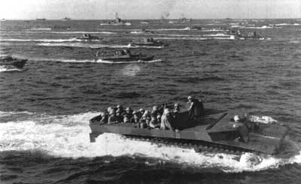
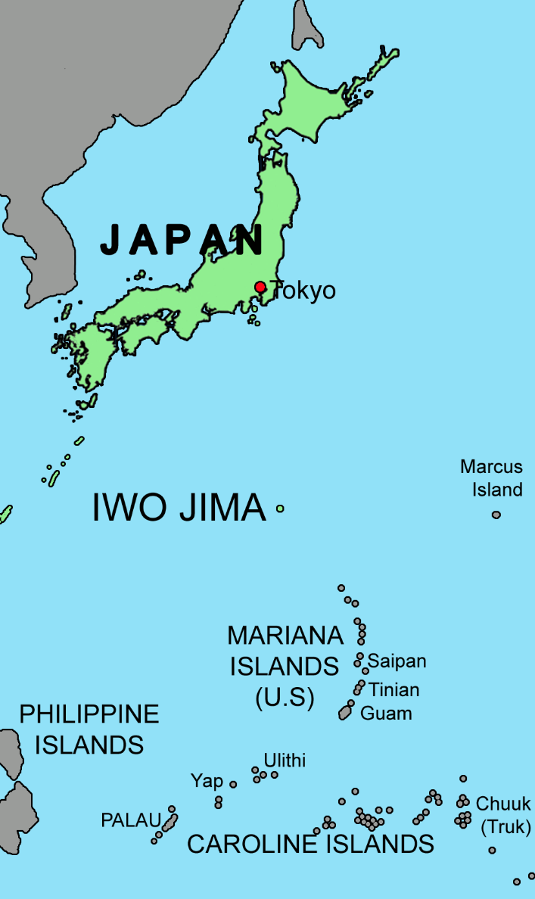
US Marines Approach Iwo Jima
© Brain Wrinkles

Slide 15
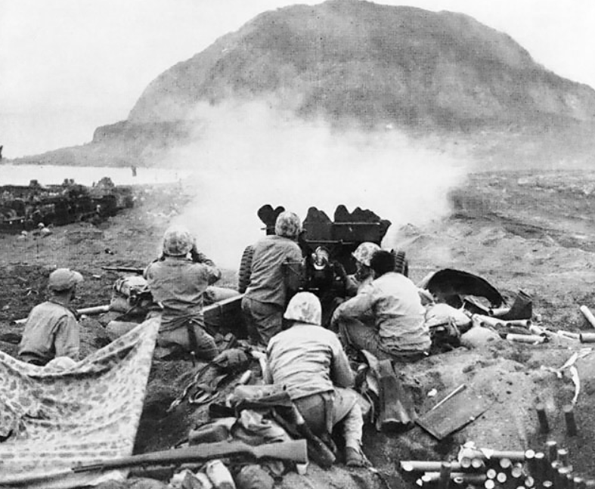
US Marines Fire at Japanese Cave Positions in Iwo Jima.
© Brain Wrinkles

Slide 16
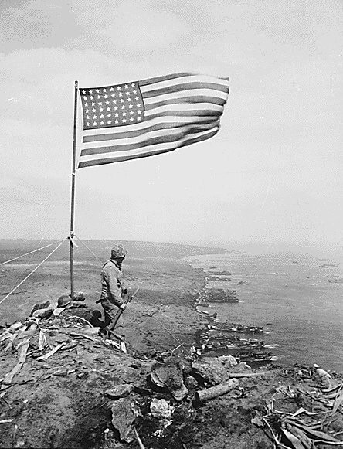
US Marines finally reached the highest point on the island and raised the American flag in victory.
© Brain Wrinkles

Slide 17
Atomic Bombs
The Allies thought about invading Japan, but were worried that too many soldiers would die.
President Harry Truman made a difficult decision to use nuclear weapons against Japan.
He warned the Japanese government to surrender, but they refused to give up.
© Brain Wrinkles

Slide 18
Atomic Bombs
On August 6, 1945, an American bomber plane dropped the first atomic bomb ever used in war on the Japanese city of Hiroshima.
A few days later, the US dropped a second bomb on Nagasaki.
Both cities were completely devastated, and the Japanese finally agreed to surrender.
Japan is the only country in the world that has been attacked by nuclear weapons.
© Brain Wrinkles

Slide 19
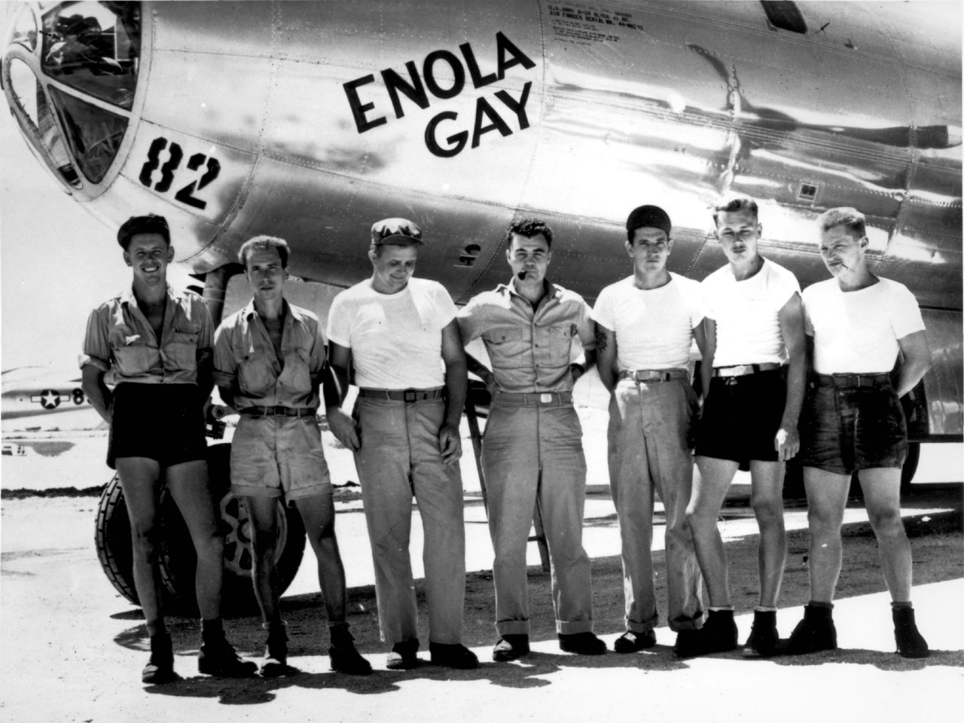
The Enola Gay dropped the “Little Boy” Atomic Bomb on Hiroshima.
© Brain Wrinkles

Slide 20
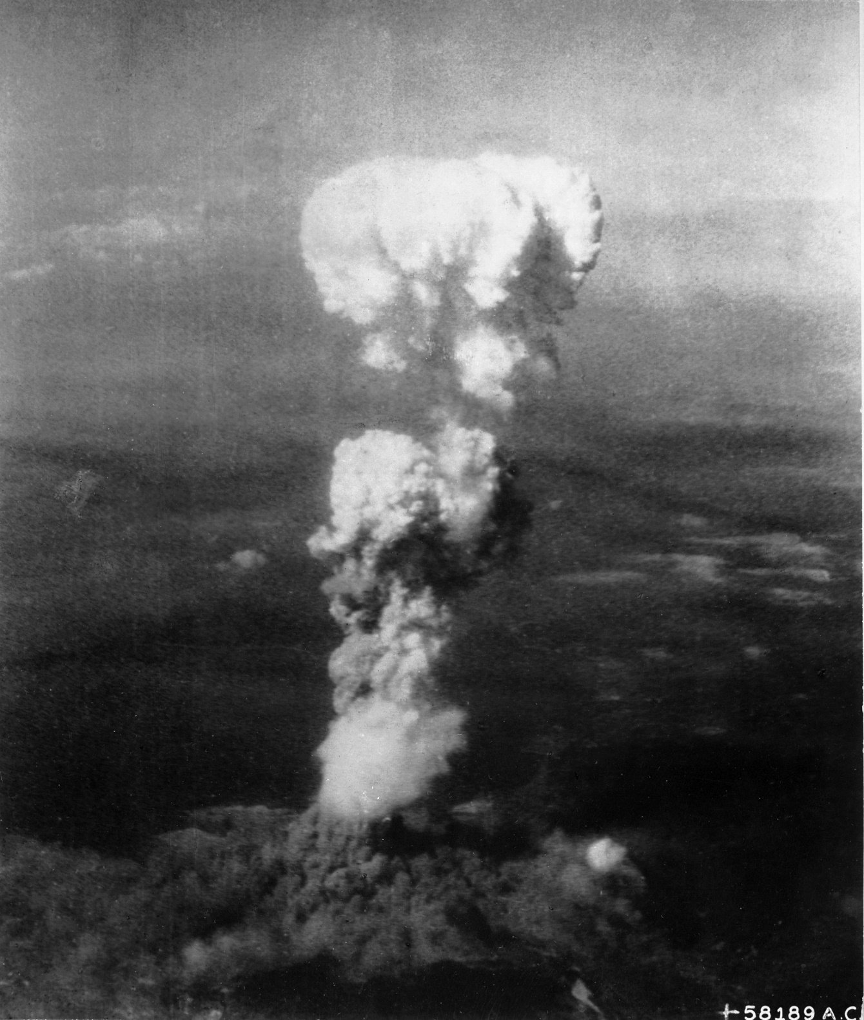
Mushroom Cloud Over Hiroshima
© Brain Wrinkles

Slide 21
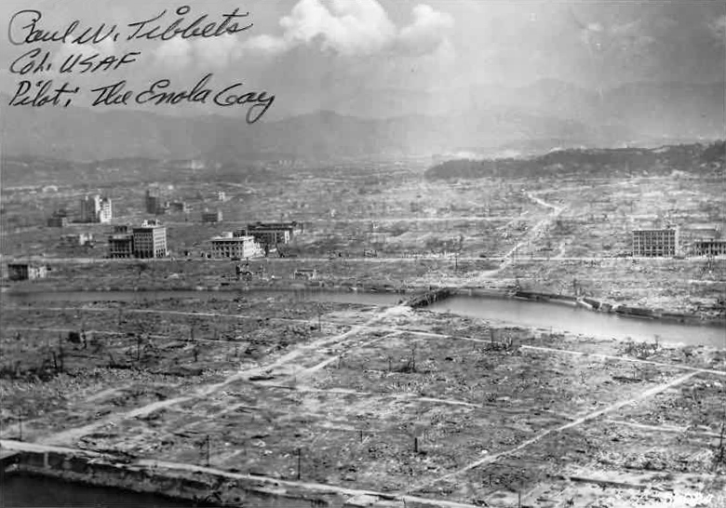
Hiroshima Aftermath
© Brain Wrinkles

Slide 22
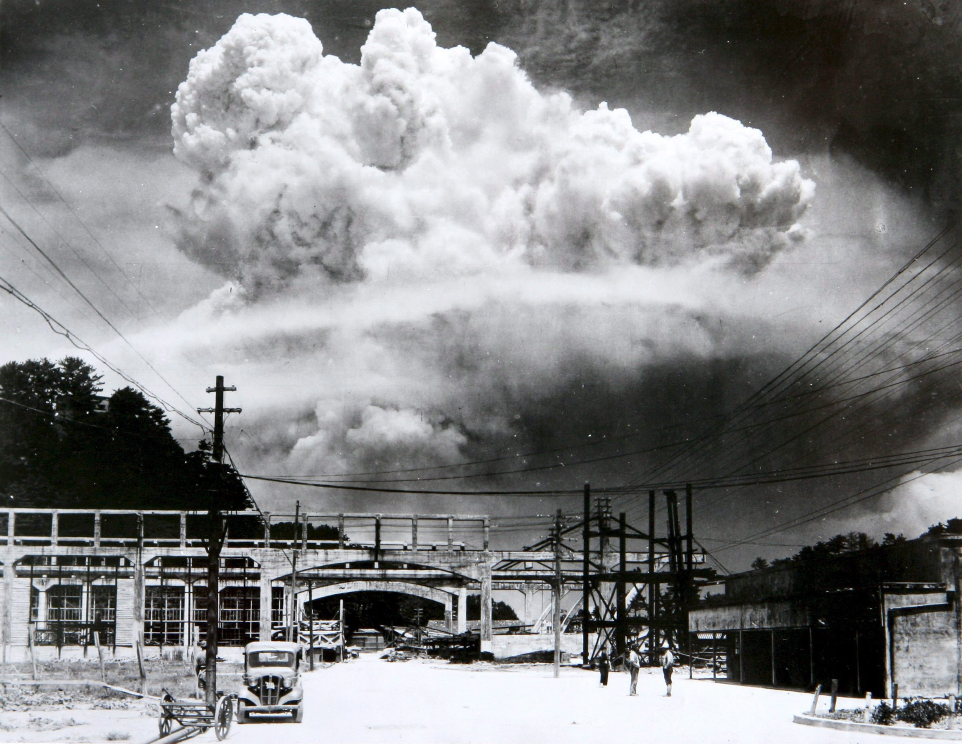
Mushroom Cloud Over Nagasaki
© Brain Wrinkles

Slide 23
VJ Day
The two sides signed formal surrender papers on the US battleship Missouri on September 2, 1945.
This day is known as VJ Day – Victory in Japan Day– and it officially put an end to Japan’s empire-building.
© Brain Wrinkles

Slide 24
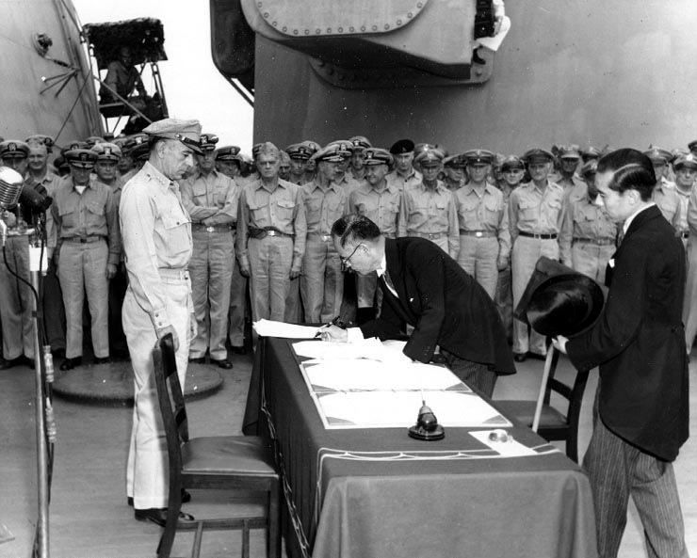
Japan Surrenders Aboard the USS Missouri,
September 2, 1945
© Brain Wrinkles

Slide 25
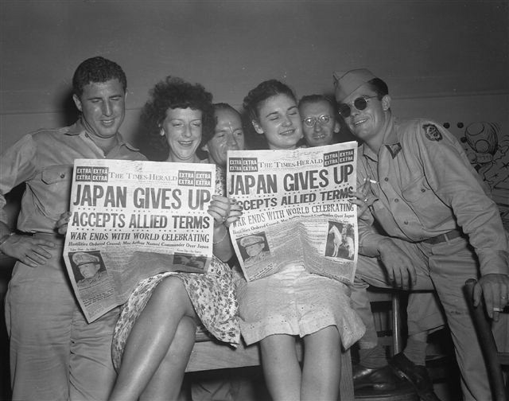
© Brain Wrinkles

Slide 26
Rebuilding
JAPAN
© Brain Wrinkles

Slide 27
Destruction
After Japan’s surrender, Japan’s economy and government were devastated.
The country’s infrastructure (transportation, communication, sewage, water, and electric systems) was demolished.
Industries and farms were destroyed and the emperor was exposed as a mere mortal and not a god.
© Brain Wrinkles

Slide 28
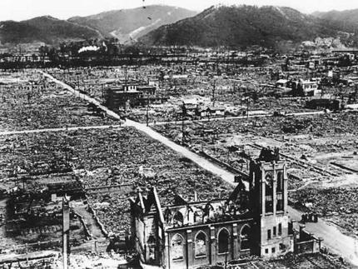
© Brain Wrinkles

Slide 29
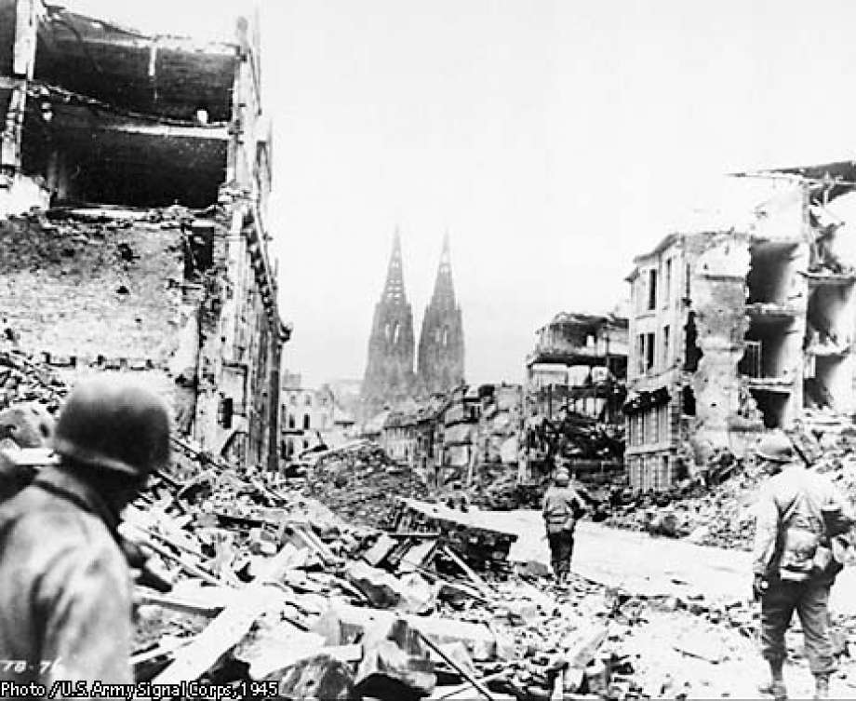
© Brain Wrinkles

Slide 30
Occupation
The US had a plan to occupy and rebuild Japan in a way that would guarantee the country would not pose a military threat to others in the future.
General Douglas MacArthur, who had commanded the Allied forces in the Pacific, was sent to oversee Japan’s restoration.
After World War II, the US occupied Japan from 1945 to 1952.
© Brain Wrinkles

Slide 31
MacArthur
General MacArthur ordered Japan’s military to be disbanded and closed all weapons factories.
He also directed that government and military leaders involved in World War II were brought to trial and punished.
In addition, MacArthur helped Japan install a new democratic government.
© Brain Wrinkles

Slide 32
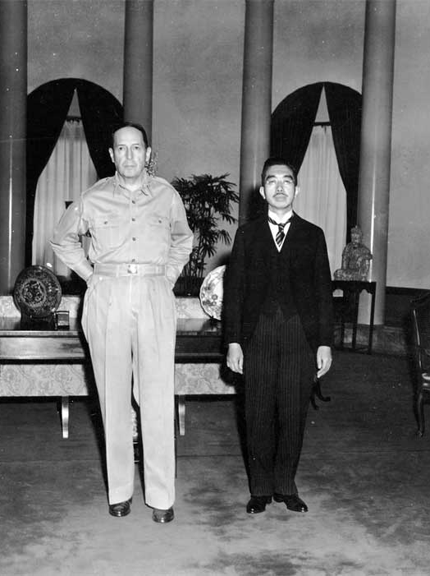
General Douglas MacArthur
and
Emperor Hirohito
© Brain Wrinkles

Slide 33
Government
MacArthur decided that Japan would be a constitutional monarchy in order to preserve the emperor’s role in the country’s culture.
He wrote Japan’s constitution, The MacArthur Constitution, which is still considered one of the most democratic documents in the world today.
Japanese citizens were granted many of the same rights as American citizens.
© Brain Wrinkles

Slide 34
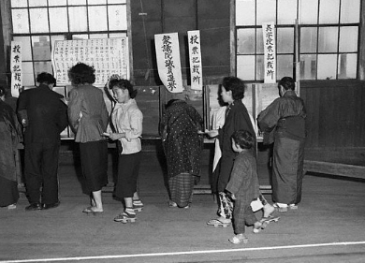
Elections in Tokyo
1952
© Brain Wrinkles

Slide 35
Reparations
Japan’s constitution also prevents the country from declaring war or fighting with other countries (unless they are attacked first).
After signing the new constitution, the Japanese government pledged to pay reparations to the countries that they harmed during WWII.
The Japanese were also not allowed to rebuild their military in any way.
© Brain Wrinkles

Slide 36
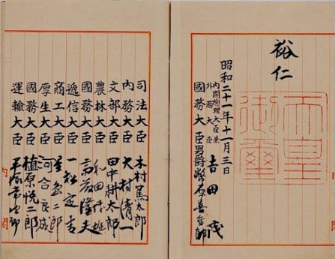
Japan’s Constitution
© Brain Wrinkles

Slide 37
Support
The United States offered financial support to help kick start Japan’s economy after World War II.
The US invested several billion dollars into rebuilding Japan.
Not all Americans supported the expense, but the government had its reasons to help Japan rebuild.
The US government knew that a friendly Japan would be a valuable trading partner in the future.
© Brain Wrinkles

Slide 38
Communism
The US government also wanted a democratic government to counteract the spread of Communism in Southern and Eastern Asia.
Communism was getting more and more popular in China, Korea, and Vietnam.
The US government saw this as a threat to democracy, and desired to keep the Japanese from being drawn to Communism.
© Brain Wrinkles

Slide 39
Economy
The United States’ efforts, coupled with a strong Japanese work ethic, led to a boom in Japan’s economic growth.
Japan now has one of the most powerful industrialized economies in the world.
America’s occupation and MacArthur’s rebuilding of Japan has had a positive lasting effect.
© Brain Wrinkles

Slide 40
Today
On April 28, 1952, Japan became a fully sovereign nation.
Today, the country has one of the most stable democratic governments in the world.
The US and Japan have remained close allies and trade partners since the 1950s.
© Brain Wrinkles

Slide 41
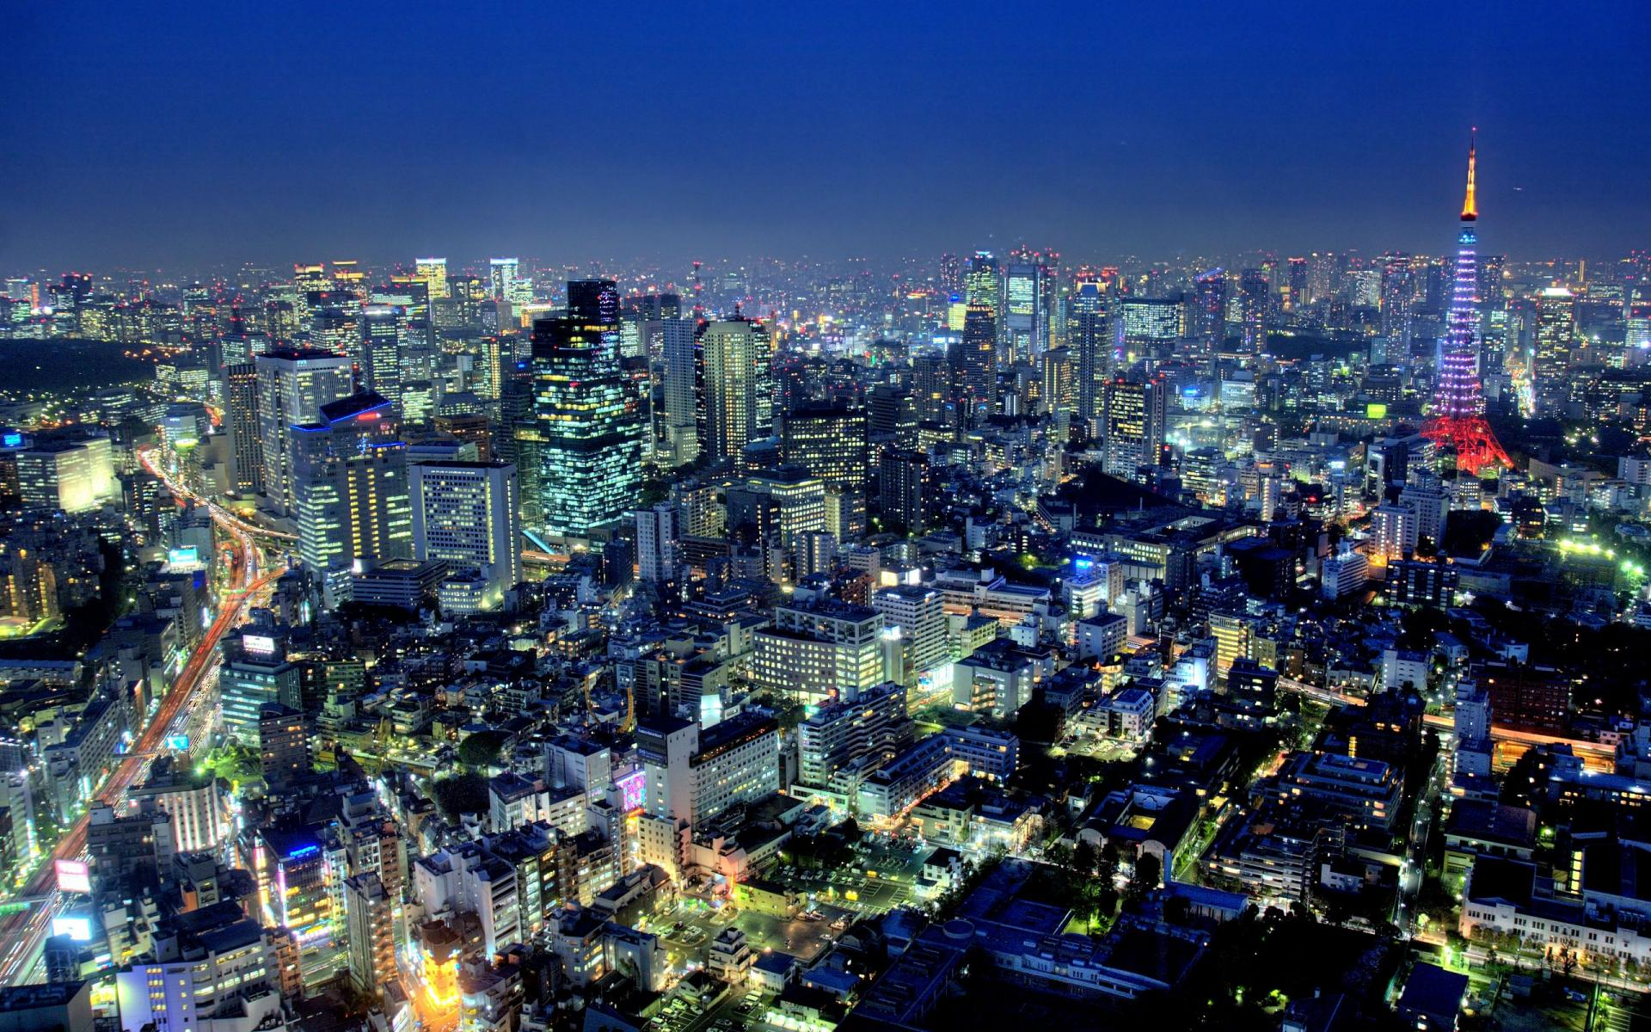
Tokyo, Japan
© Brain Wrinkles

