Slide 1
SS8H6c
Georgia’s History:
Reconstruction
© 2014 Brain Wrinkles

Slide 2
Standards
SS8H6 The student will analyze the impact of the Civil War and Reconstruction on Georgia.
c. Analyze the impact of Reconstruction on Georgia and other southern states, emphasizing Freedmen’s Bureau; sharecropping and tenant farming; Reconstruction plans; 13th, 14th, and 15th amendments to the constitution; Henry McNeal Turner and black legislators; and the Ku Klux Klan.
© 2014 Brain Wrinkles

Slide 3
SS8H6c
Georgia’s History:
Reconstruction
© 2014 Brain Wrinkles

Slide 4
Reconstruction
Reconstruction means to build something again.
It is the name given to the time period after the Civil War, from 1865 to 1877.
Georgia and the other southern states needed to be rebuilt and brought back into the Union.
© 2014 Brain Wrinkles

Slide 5
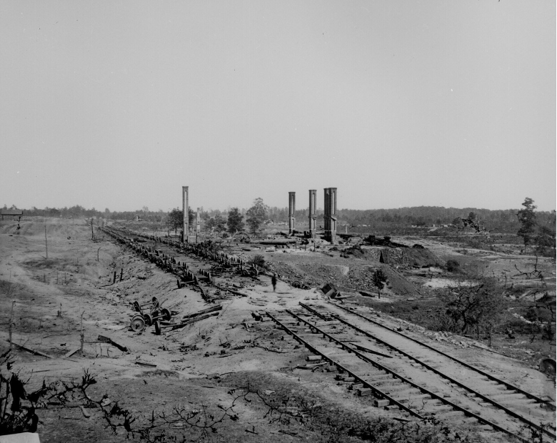
Railroad Lines Ruins that had to be Rebuilt
Atlanta 1864
© 2014 Brain Wrinkles

Slide 6
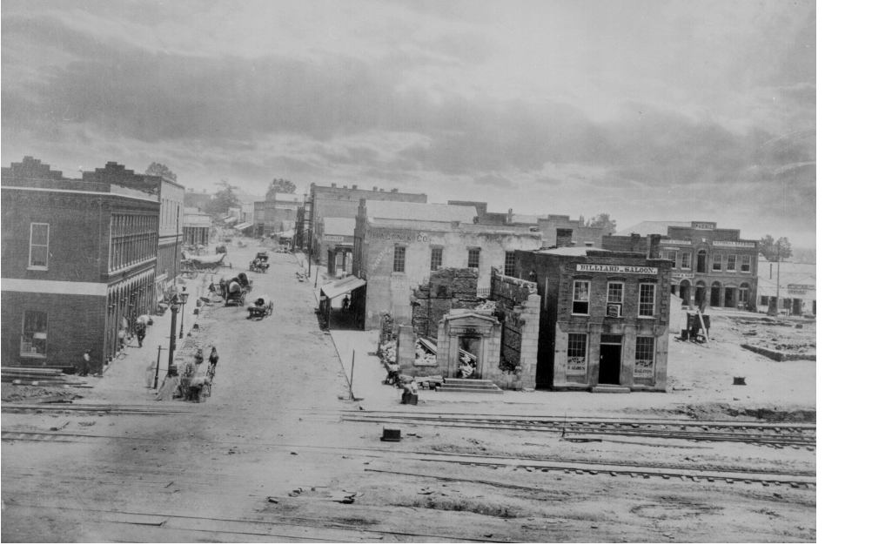
Ruins on Peachtree Street
Atlanta 1864
© 2014 Brain Wrinkles

Slide 7
Reconstruction
President Lincoln’s plan for rebuilding the South had three parts:
First, one-tenth of the people in the state had to take an oath to obey the U.S. Constitution.
Second, the state had to set up a new government.
Third, they had to abolish slavery.
© 2014 Brain Wrinkles

Slide 8
Reconstruction
While Lincoln wanted to be fair to the South, many Radical Republicans felt that Lincoln’s plan was too lenient.
They felt that Southern states should be punished for their actions during the Civil War.
© 2014 Brain Wrinkles

Slide 9
13th Amendment
After Lincoln’s assassination, Andrew Johnson took over the presidency and committed to carrying out Lincoln’s Reconstruction plan.
In December 1865, ratification of the Thirteenth Amendment to the Constitution freed all slaves in the United States.
It banned slavery in the US and any of its territories.
President Johnson said that once the amendment passed, Southern states could come back into the Union.
© 2014 Brain Wrinkles

Slide 10
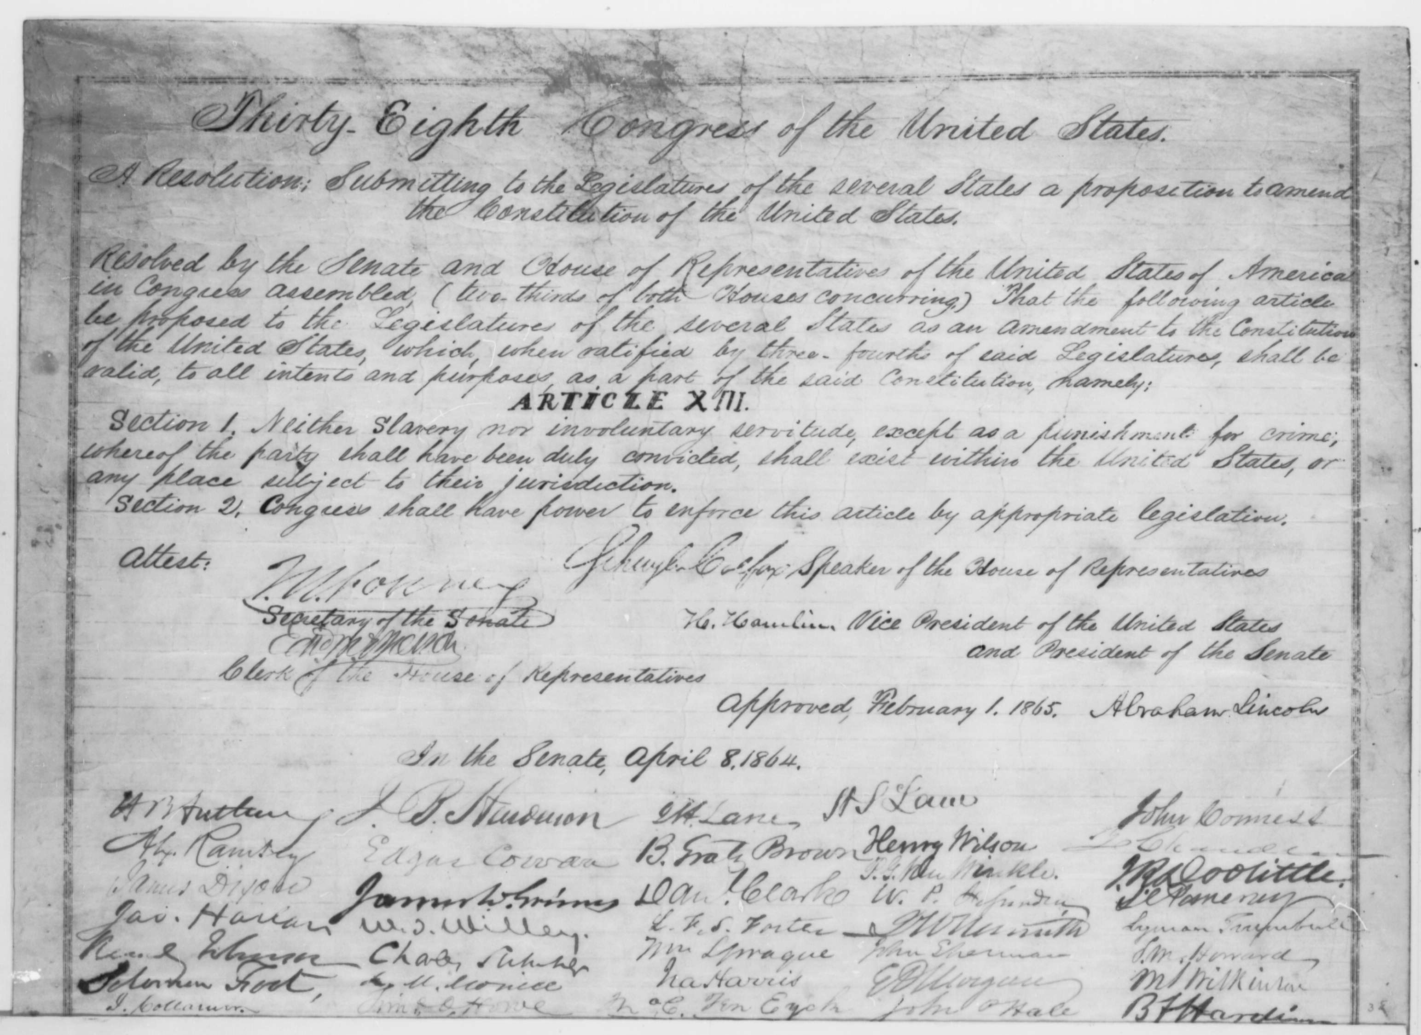
13th Amendment
It was approved by Abraham Lincoln in February, but was not ratified until December.
© 2014 Brain Wrinkles

Slide 11
14th Amendment
In 1868, the Fourteenth Amendment made all former slaves citizens of the United States.
It granted citizenship to all persons born in the United States, and it guaranteed all citizens equal rights under the law.
At first, Tennessee was the only Southern state to approve it, but Congress told the states they must approve it to be readmitted to the Union.
© 2014 Brain Wrinkles

Slide 12
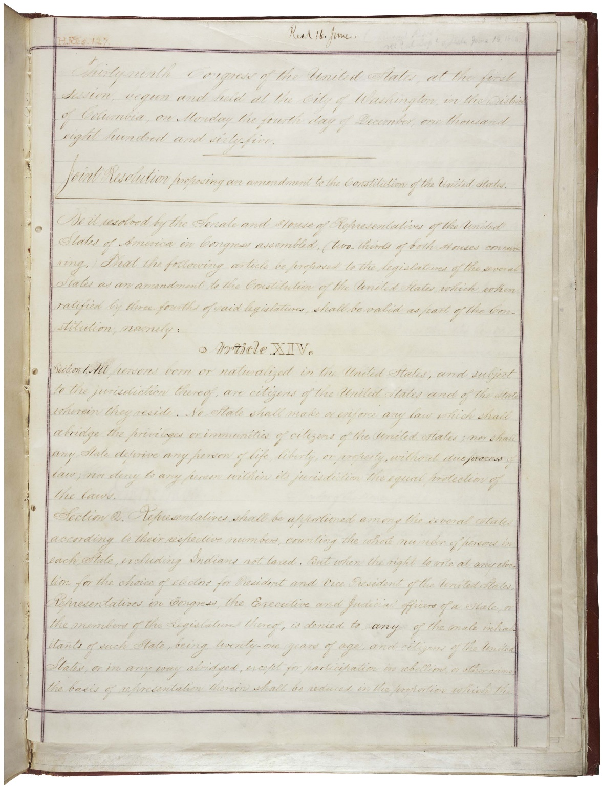
14th Amendment
(Original)
© 2014 Brain Wrinkles

Slide 13
15th Amendment
In 1870, the Fifteenth Amendment declared that no citizen of the United States could be denied the right to vote on account of race, color, or previous servitude.
It granted the right to vote to all male citizens.
African Americans could now vote and run for office.
© 2014 Brain Wrinkles

Slide 14
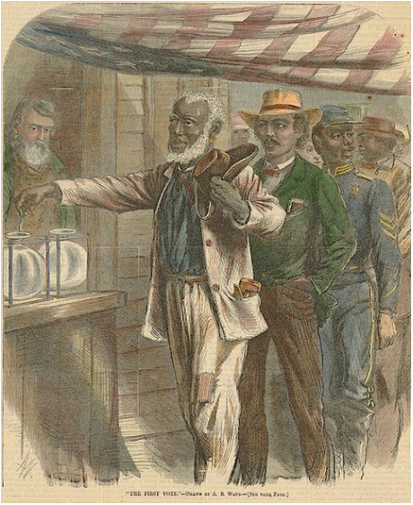
“The First Vote”
© 2014 Brain Wrinkles

Slide 15
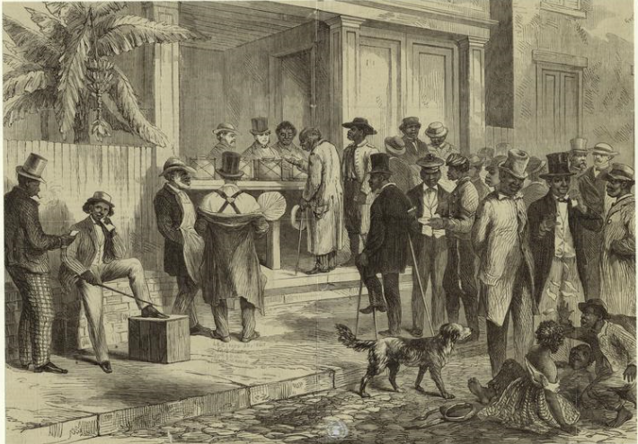
Freedmen Voting in New Orleans, 1867
© 2014 Brain Wrinkles

Slide 16
Freedmen’s Bureau
In March 1865, the federal government set up the Freedmen’s Bureau, an organization that helped feed, clothe, and provide medical care to former slaves.
It also established thousands of schools and helped African Americans with legal problems.
The bureau also helped poor whites, many of whom lost everything in the war.
© 2014 Brain Wrinkles

Slide 17
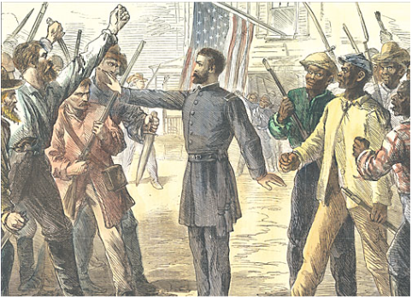
A Freedmen’s Bureau Agent Stands Between Armed Groups of Whites and Freed men
1868
© 2014 Brain Wrinkles

Slide 18
Freedmen’s Bureau
Georgia had a higher population of freed black slaves (who were uneducated and unemployed) than any other state.
Educating slaves was forbidden in Georgia prior to the Civil War.
The Freedmen’s Bureau created the first public school program for blacks and whites in the state and set the stage for Georgia’s modern public school system.
It established Clarke Atlanta University and Morehouse College.
© 2014 Brain Wrinkles

Slide 19
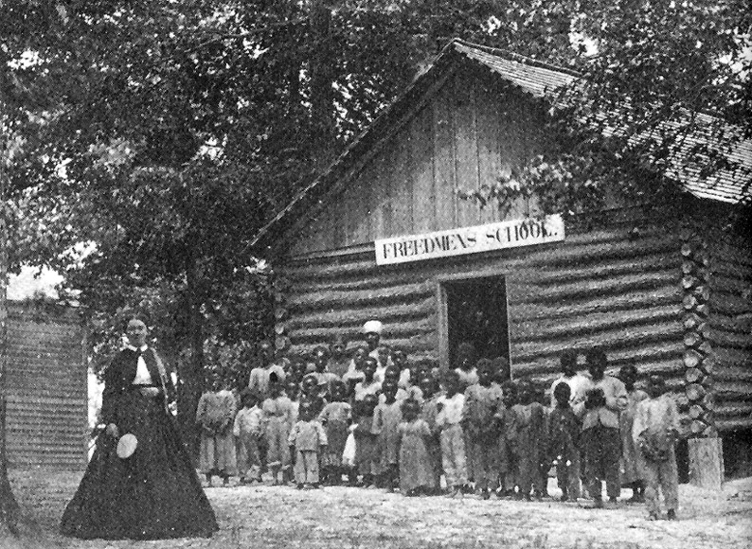
© 2014 Brain Wrinkles

Slide 20
Sharecropping
Many former slaves were forced to return to plantations because they could not find work.
Freed slaves knew how to grow crops, and landowners still needed labor.
In the sharecropping arrangement, the owner would lend the worker a place to live, his seeds, and farm equipment.
© 2014 Brain Wrinkles

Slide 21
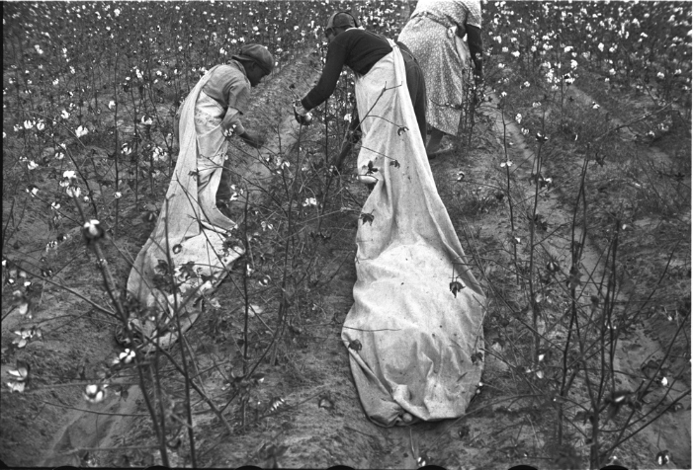
Sharecroppers Picking Cotton
© 2014 Brain Wrinkles

Slide 22
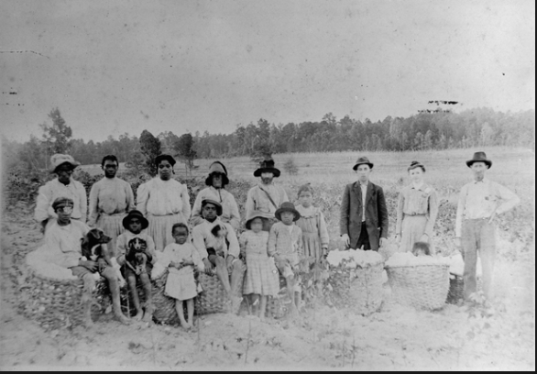
Sharecroppers and Cotton Bales
© 2014 Brain Wrinkles

Slide 23
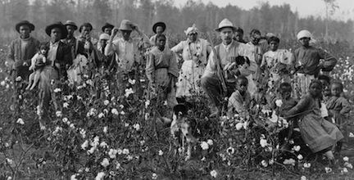
Mississippi Sharecroppers
© 2014 Brain Wrinkles

Slide 24
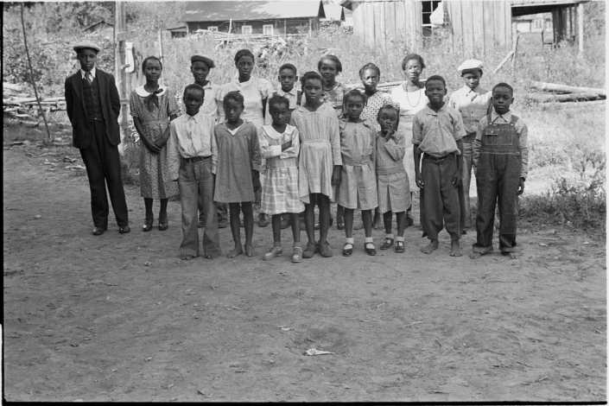
Children of African American Sharecroppers in Arkansas
© 2014 Brain Wrinkles

Slide 25
Sharecropping
Sharecroppers received almost no pay, just a small share of the crops.
Because the worker had no money for rent, he would give the owner a share of the crop, plus extra for the cost of rent and supplies.
The workers had little hope of ever owning land because they rarely made a profit.
© 2014 Brain Wrinkles

Slide 26
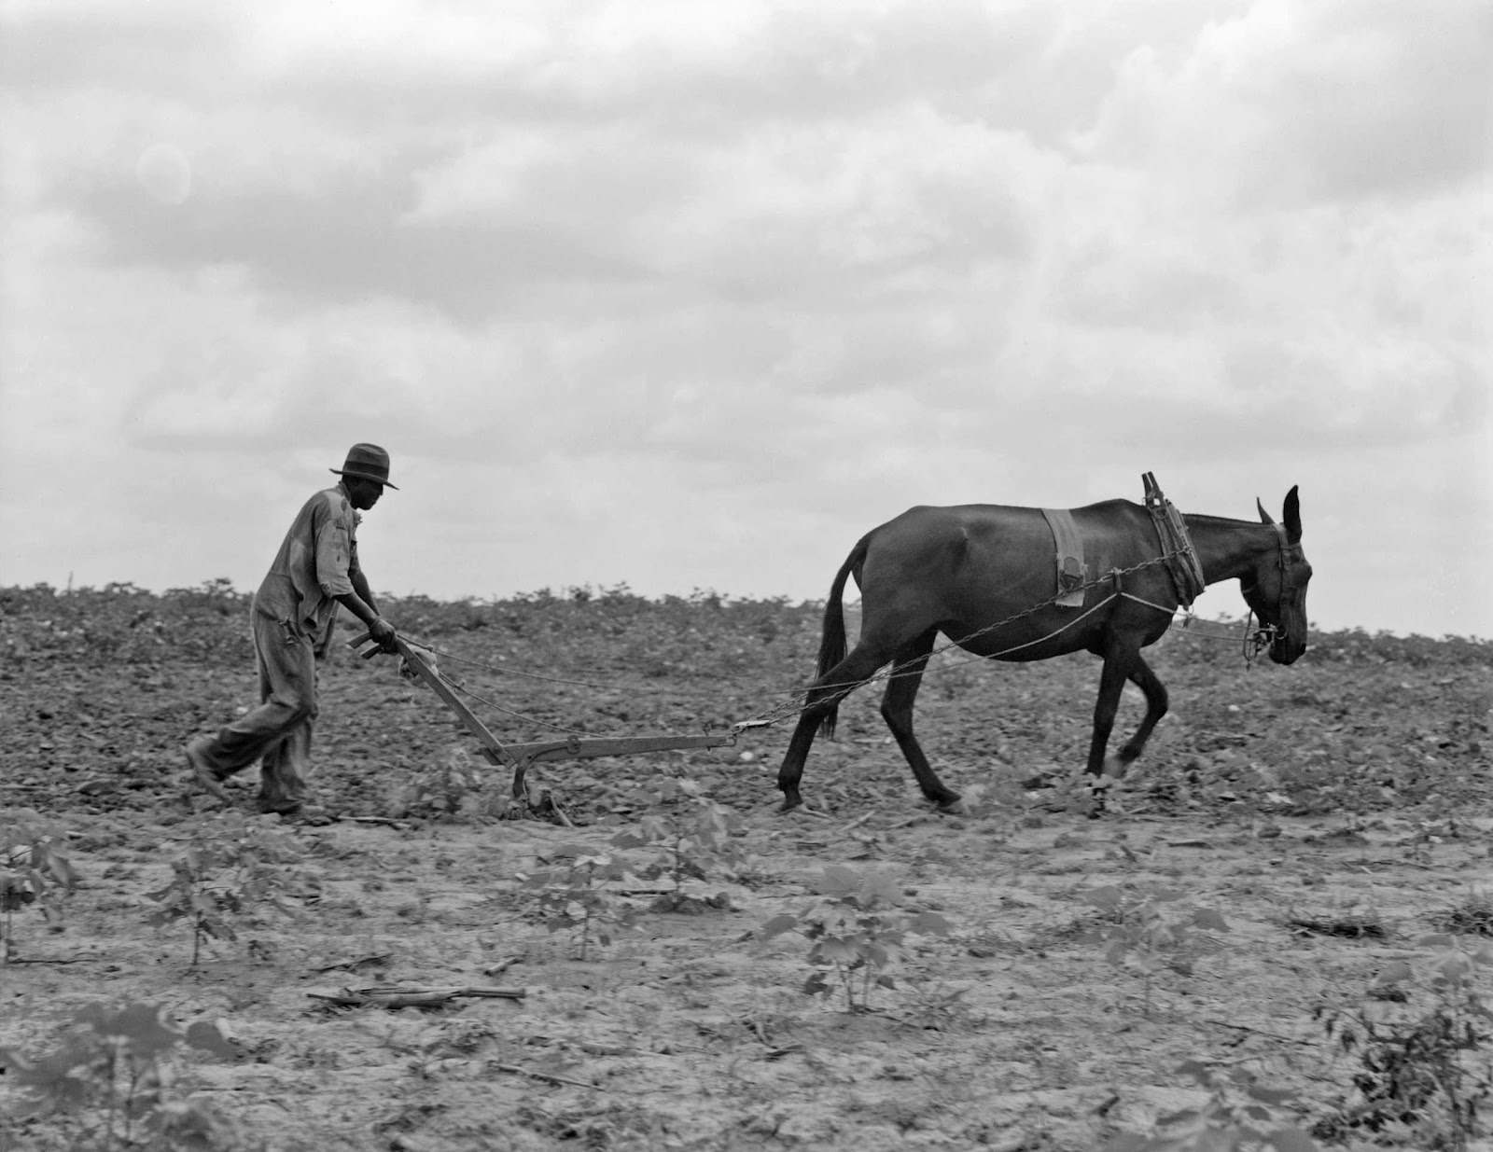
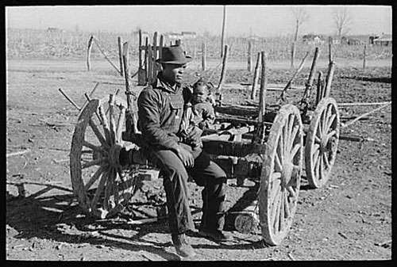
© 2014 Brain Wrinkles

Slide 27
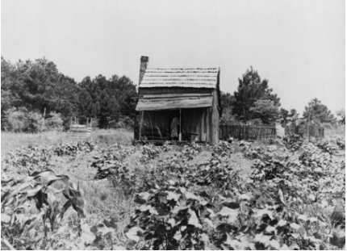
Sharecropper’s Cabin Surrounded by Cotton and Corn
© 2014 Brain Wrinkles

Slide 28
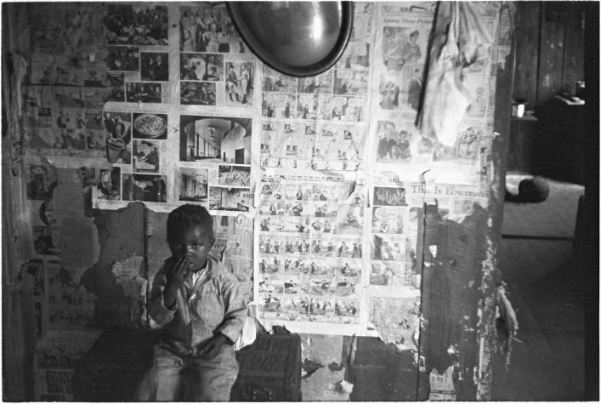
Inside a Sharecropper’s Home
© 2014 Brain Wrinkles

Slide 29
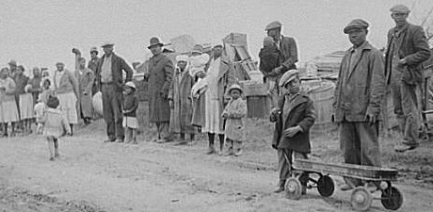
The Families of Evicted Sharecroppers in Arkansas
© 2014 Brain Wrinkles

Slide 30
Tenant Farmers
Tenant farmers made similar arrangements with landowners where they rented sections of land.
However, unlike sharecroppers, tenant farmers often owned animals, equipment, and supplies, so they received more of the harvest.
Even so, after money was deducted for rent, there was little left over for the farmer.
It was impossible to get ahead as a sharecropper or tenant farmer.
© 2014 Brain Wrinkles

Slide 31
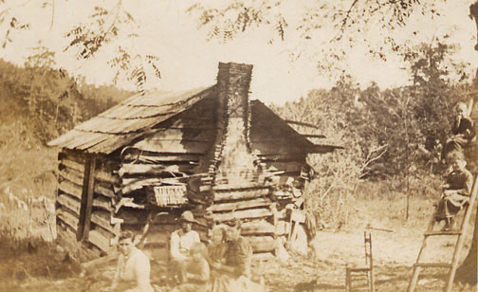
© 2014 Brain Wrinkles

Slide 32
Right to Vote
For a brief period during Reconstruction, Freedmen were given more political rights than they had ever had (and would not have again for 100 years).
With this freedom, 32 black legislators were elected to the Georgia General Assembly in 1867.
Among the delegates was Henry McNeal Turner, an educated minister who had served as the first black chaplain in the U.S. Army.
© 2014 Brain Wrinkles

Slide 33
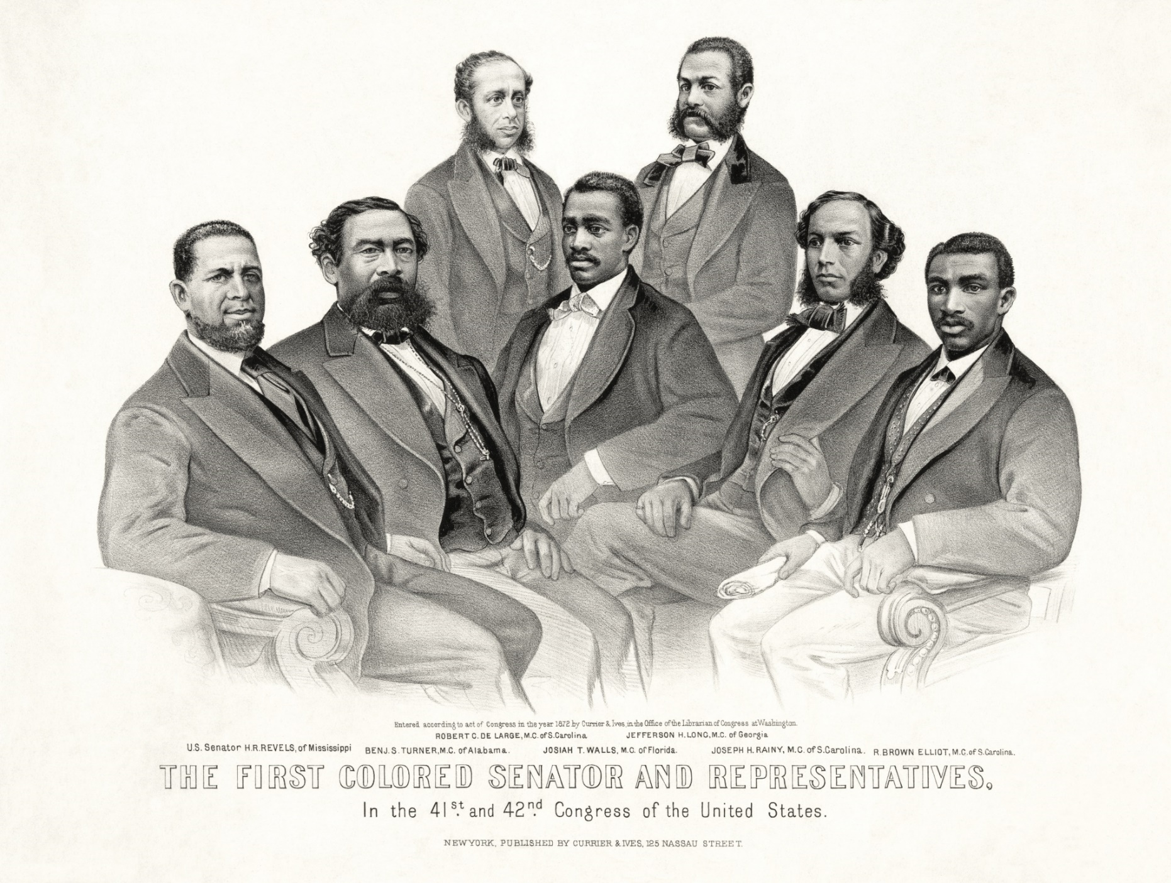
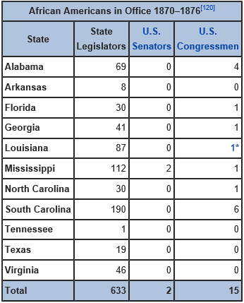
© 2014 Brain Wrinkles

Slide 34
Ku Klux Klan
The first Ku Klux Klan (KKK) began in 1867 as a social club for former confederate soldiers; however, they became more political and violent.
The Ku Klux Klan used violence to frighten African-Americans and keep them from exercising their civil rights.
Klansmen dressed up in white sheets and hooded masks, and would terrorize blacks (and whites who tried to help them).
© 2014 Brain Wrinkles

Slide 35
Ku Klux Klan
The KKK used tactics of intimidation, physical violence, and murder in hopes of establishing social control over African Americans and their white allies.
The KKK grew in Georgia and the southern United States both during and after Reconstruction.
White supremacy and racial segregation became the norm in Georgia, and the rest of the South, for several decades.
© 2014 Brain Wrinkles

Slide 36
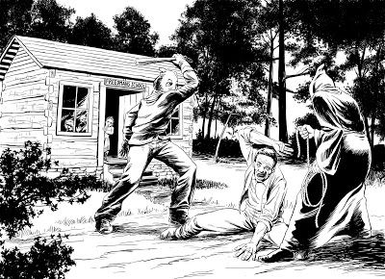
© 2014 Brain Wrinkles

Slide 37
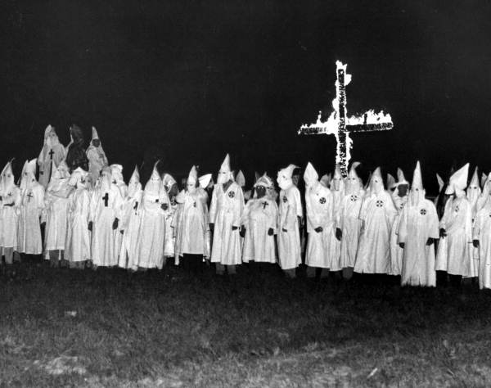
© 2014 Brain Wrinkles

Slide 38
Amendments
 | 13th | 14th | 15th
Description
Symbol
© 2014 Brain Wrinkles

Slide 39
Amendment Commemorative Stamps
Directions: Design a stamp to represent the 13th, 14th, and 15th Amendments to the U.S. Constitution. Also, write a caption that describes each stamp’s design.
© 2014 Brain Wrinkles

Slide 40
Job Description: ______________________________________________________________________________________________________________________________________________________________________________
____________________________________________________________________________________________________________________
____________________________________________________________________________________________________________________
Logo
Name: __________________________
Company: ______________________
Number: _______________________
Slogan: ____________________________________________________________________________________________________________________________________________________________________________________________________________________________________________________
Awards: _______________________________________________________________________________________
© 2014 Brain Wrinkles

Slide 41
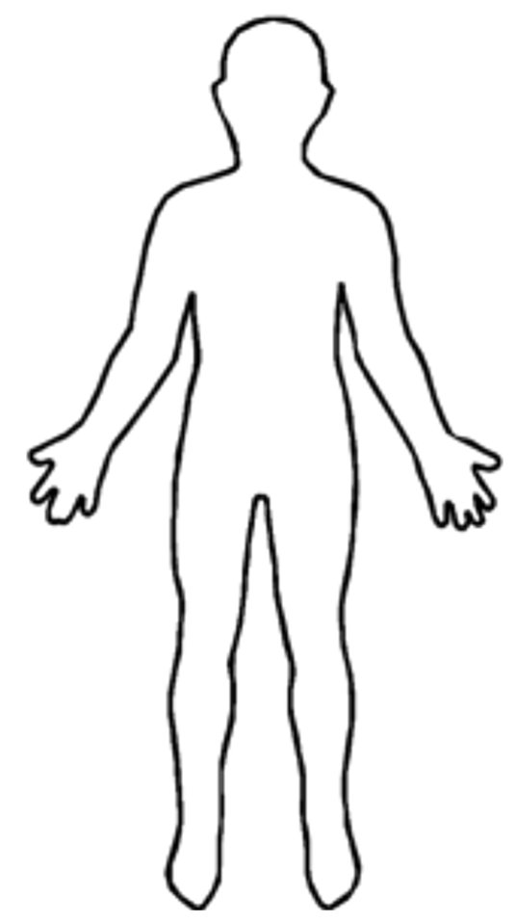
Reconstruction Caricatures
Directions: Create a caricature for former slave and a plantation owner during Reconstruction. Draw clothing and belongings/items on each person that represents the person’s situation during Reconstruction.
Former Slave
How has Reconstruction affected your life?
How do you feel about the new Amendments?
What changes would you like to see in the government?
Plantation Owner
How has Reconstruction affected your life?
How do you feel about the new Amendments?
What changes would you like to see in the government?
© 2014 Brain Wrinkles

Slide 42
KKK WANTED Poster
Directions: Created a WANTED Poster for the Ku Klux Klan. Include information about the KKK, a description of the KKK’s crimes, and a photograph.
WANTED: __________________________
Reward Amount:
Who is this group?
What crimes did this group commit?
© 2014 Brain Wrinkles

Slide 43
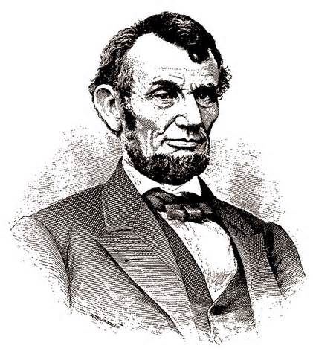
What Would Lincoln Think?
Directions: What would Lincoln think about what happened during Reconstruction? Do you think he would agree with the amendments and plans put into place? How do you think he would react to the South’s treatment of former slaves? Write a paragraph sharing Lincoln’s “thoughts” below.
© 2014 Brain Wrinkles

Slide 44
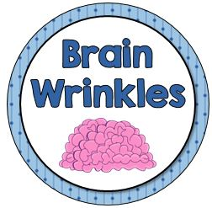
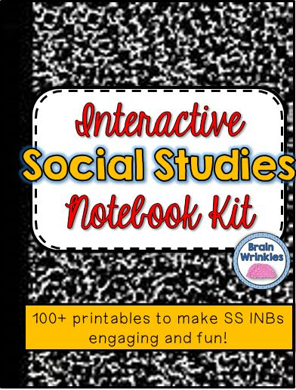
Thank You!
Thank you so much for downloading this file. I sincerely hope you find it helpful and that your students learn a lot from it! I look forward to reading your feedback in my store.
If you like this file, you might want to check out some of my other products that teach social studies topics in creative, engaging, and hands-on ways.
Best of luck to you this school year,
Ansley at Brain Wrinkles
© 2014 Brain Wrinkles

Slide 45
Terms of Use
© 2014 Brain Wrinkles. Your download includes a limited use license from Brain Wrinkles. The purchaser may use the resource for personal classroom use only. The license is not transferable to another person. Other teachers should purchase their own license through my store.
This resource is not to be used:
By an entire grade level, school, or district without purchasing the proper number of licenses. For school/district licenses at a discount, please contact me.
As part of a product listed for sale or for free by another individual.
On shared databases.
Online in any way other than on password-protected website for student use only.
© Copyright 2014. Brain Wrinkles. All rights reserved. Permission is granted to copy pages specifically designed for student or teacher use by the original purchaser or licensee. The reproduction of any other part of this product is strictly prohibited. Copying any part of this product and placing it on the Internet in any form (even a personal/classroom website) is strictly forbidden. Doing so makes it possible for an Internet search to make the document available on the Internet, free of charge, and is a violation of the Digital Millennium Copyright Act (DMCA).
Thank you,
Ansley at Brain Wrinkles
Clipart, fonts, & digital papers for this product were purchased from:
© 2014 Brain Wrinkles

