Slide 1
VOCAB OF se aSIA
GEOGRAPHY/ENVIRONMENT

Slide 2
SUBCONTINENT
LARGE LAND AREA THAT IS MOSTLY SEPARATE FROM A CONTNENT
EXAMPLE: iNDIA
This Photo by Unknown Author is licensed under CC BY-SA

Slide 3
TECTONIC pLATE
A SEPARATE AREA OF Earth’s crust
Example: India and China on separate plates creates the Himalayan mountains
This Photo by Unknown Author is licensed under CC BY-SA

Slide 4
archipelago
A chain of islands
Example: japan
This Photo by Unknown Author is licensed under CC BY-SA

Slide 5
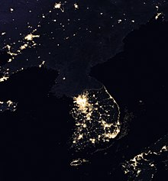
peninsula
Landform that is surrounded on three sides by water
Example: Korean Peninsula
This Photo by Unknown Author is licensed under CC BY-SA
This Photo by Unknown Author is licensed under CC BY-SA

Slide 6
Monsoon season
A season when prevailing winds bring devastating floods
Example: 75% of India’s annual rainfall occurs during monsoon season.
This Photo by Unknown Author is licensed under CC BY-SA

Slide 7
Three Gorges dam
Located on the Yangtze river and produces the most hydroelectric power (basically electricity produced from water power) in the world.
Largest hydroelectric dam in the world.
This Photo by Unknown Author is licensed under CC BY

Slide 8
Acid rain
Occurs when chemicals in the air—especially sulfur dioxide and nitrogen oxides (from fossil fuels) react with the moisture in the atmosphere.
Ex: China—hurts animals, plants, buildings
This Photo by Unknown Author is licensed under CC BY-SA

Slide 9
smog
Severe air pollution (smoke+Fog)
Ex: Beijing
This Photo by Unknown Author is licensed under CC BY

Slide 10
arsenic
Poisonous chemical found in water of Yangtze River (China)
EX: High levels or ingesting over time leads to cancers and organ failure.
This Photo by Unknown Author is licensed under CC BY-SA-NC

Slide 11
Respiratory disease
Diseases of the lungs, bronchial tubes, and trachea
Breathing unfiltered air in Mumbai for ONE day is the same as smoking 100 cigarettes.
This Photo by Unknown Author is licensed under CC BY-NC-ND

Slide 12
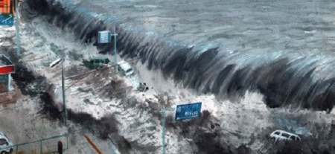
tsunami
A long high sea wave caused by an earthquake.
Ex: japan in 2011; Honshu island
This Photo by Unknown Author is licensed under CC BY-NC-ND
This Photo by Unknown Author is licensed under CC BY-SA-NC

Slide 13
typhoons
Tropical hurricanes
Same as us hurricanes
This Photo by Unknown Author is licensed under CC BY-SA-NC

Slide 14
homogenous
Similar (not diverse)
Populations of North/South Korea and Japan
This Photo by Unknown Author is licensed under CC BY-NC-ND

