Slide 1
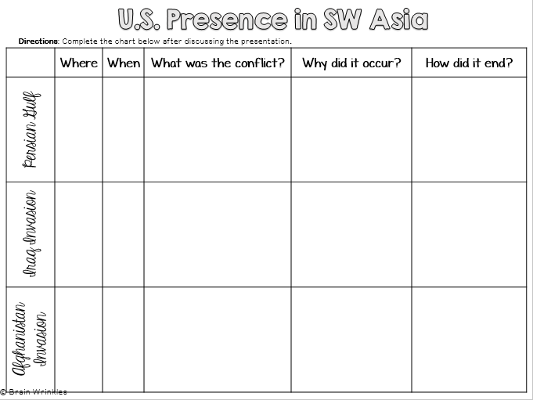
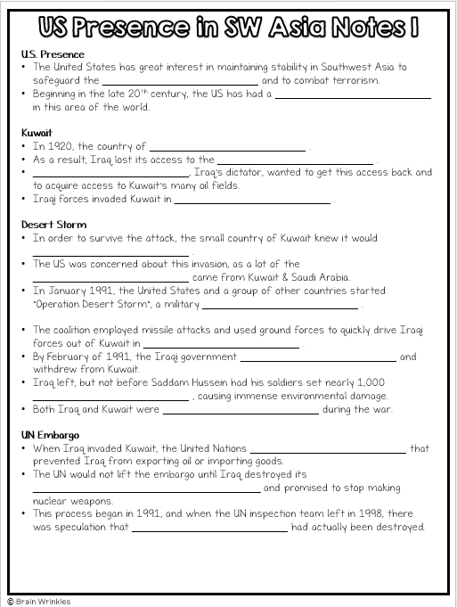
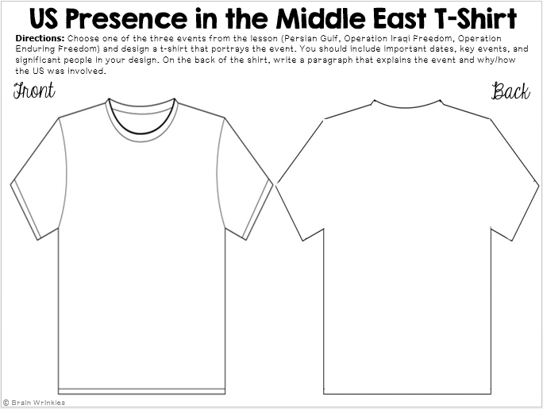
U.S. PRESENCE
U.S. PRESENCE
in Southwest Asia
Presentation, Graphic Organizers, & Activities

Slide 2
STANDARDS:
SS7H2 Analyze continuity and change in Southwest Asia (Middle East).
d. Explain U.S. presence and interest in Southwest Asia, including the Persian Gulf conflict and invasions of Afghanistan and Iraq.
© Brain Wrinkles

Slide 3
TEACHER INFO: CLOZE Notes
The next pages are handouts for the students to use for note-taking during the presentation. (Print front to back to save paper and ink.)
Check the answers as a class after the presentation.
© Brain Wrinkles

Slide 4
U.S. Presence
The United States has great interest in maintaining stability in Southwest Asia to safeguard the __________________________ and to combat terrorism.
Beginning in the late 20th century, the US has had a __________________________ in this area of the world.
Kuwait
In 1920, the country of __________________________ .
As a result, Iraq lost its access to the __________________________ .
__________________________, Iraq’s dictator, wanted to get this access back and to acquire access to Kuwait’s many oil fields.
Iraqi forces invaded Kuwait in __________________________ .
Desert Storm
In order to survive the attack, the small country of Kuwait knew it would __________________________ .
The US was concerned about this invasion, as a lot of the __________________________ came from Kuwait & Saudi Arabia.
In January 1991, the United States and a group of other countries started “Operation Desert Storm”, a military __________________________ .
The coalition employed missile attacks and used ground forces to quickly drive Iraqi forces out of Kuwait in __________________________ .
By February of 1991, the Iraqi government __________________________ and withdrew from Kuwait.
Iraq left, but not before Saddam Hussein had his soldiers set nearly 1,000 __________________________ , causing immense environmental damage.
Both Iraq and Kuwait were __________________________ during the war.
UN Embargo
When Iraq invaded Kuwait, the United Nations __________________________ that prevented Iraq from exporting oil or importing goods.
The UN would not lift the embargo until Iraq destroyed its ______________________________________ and promised to stop making nuclear weapons.
This process began in 1991, and when the UN inspection team left in 1998, there was speculation that __________________________ had actually been destroyed.
© Brain Wrinkles
US Presence in SW Asia Notes 1

Slide 5
Iraq
After the UN inspection team left, many Americans believed that Hussein was hiding __________________________ (WMDs) throughout the country, as well as providing aid to __________________________ .
In 2003, the United States, Great Britain, Australia, & other countries launched a military invasion of Iraq called “__________________________ ”.
Results
Saddam Hussein’s __________________________ , and the military operation was over in less than two months.
__________________________ were ever found.
In __________________________ , Hussein was captured, tried, and sentenced to death.
__________________________ in December 2006.
Iraq Today
Rebuilding Iraq after the invasion __________________________ .
In 2005, Iraqi citizens took part in free elections to establish a new __________________________ .
U.S. forces remained in Iraq until the new Iraqi government was __________________________ .
In December 2011, the __________________________ .
Unfortunately, there is still conflict in Iraq today, as the __________________________ are fighting one another for power of the country.
© Brain Wrinkles
US Presence in SW Asia Notes 2

Slide 6
Bin Laden
In 1996, the Taliban (an __________________________ ) established power in Afghanistan.
The __________________________ was thought to be harboring Osama bin Laden’s terrorist group al-Qaeda, whose goal was to bring an __________________________ in the Middle East.
The U.S. government identified bin Laden as the most likely suspect responsible for the September 11th, 2001 attacks on the __________________________ and the Pentagon.
9/11
On September 11, 2001, al-Qaeda __________________________ in the United States.
The terrorists __________________________ .
__________________________ into the World Trade Center in New York City.
Another airplane crashed into the __________________________ , just outside of Washington, DC.
The fourth plane was intended to __________________________ , but crashed in rural Pennsylvania.
Over __________________________ in these attacks.
US Invasion
Sources in the U.S. government believed that the Taliban was allowing Bin Laden and his __________________________ in the mountains of Afghanistan.
On October 7th, 2001, U.S. troops entered Afghanistan to __________________________ and locate bin Laden.
Democracy
After launching a series of attacks, the __________________________ .
The U.S. helped form a new __________________________ in Afghanistan.
Efforts to locate bin Laden failed, and he went into hiding for the next __________________________ .
The End
On __________________________ , at 1:00 am, Navy SEALS raided Osama bin Laden’s compound in Pakistan.
Bin Laden was shot and __________________________ .
His body was taken to Afghanistan for identification, then __________________________ within 24 hours.
According to U.S. officials, bin Laden was buried at sea because __________________________ would accept his remains.
© Brain Wrinkles
US Presence in SW Asia Notes 3

Slide 7
U.S. Presence
The United States has great interest in maintaining stability in Southwest Asia to safeguard the supply of oil and to combat terrorism.
Beginning in the late 20th century, the US has had a major presence in this area of the world.
Kuwait
In 1920, the country of Kuwait was created.
As a result, Iraq lost its access to the Persian Gulf.
Saddam Hussein, Iraq’s dictator, wanted to get this access back and to acquire access to Kuwait’s many oil fields.
Iraqi forces invaded Kuwait in August 1990.
Desert Storm
In order to survive the attack, the small country of Kuwait knew it would need allies.
The US was concerned about this invasion, as a lot of the country’s oil came from Kuwait & Saudi Arabia.
In January 1991, the United States and a group of other countries started “Operation Desert Storm”, a military mission to recapture Kuwait.
The coalition employed missile attacks and used ground forces to quickly drive Iraqi forces out of Kuwait in just six weeks.
By February of 1991, the Iraqi government agreed to a truce and withdrew from Kuwait.
Iraq left, but not before Saddam Hussein had his soldiers set nearly 1,000 oil fields on fire, causing immense environmental damage.
Both Iraq and Kuwait were badly damaged during the war.
UN Embargo
When Iraq invaded Kuwait, the United Nations imposed an embargo that prevented Iraq from exporting oil or importing goods.
The UN would not lift the embargo until Iraq destroyed its chemical and biological weapons and promised to stop making nuclear weapons.
This process began in 1991, and when the UN inspection team left in 1998, there was speculation that only 85% had actually been destroyed.
© Brain Wrinkles
US Presence in SW Asia Notes 1

Slide 8
© Brain Wrinkles
Iraq
After the UN inspection team left, many Americans believed that Hussein was hiding weapons of mass destruction (WMDs) throughout the country, as well as providing aid to members of al-Qaeda.
In 2003, the United States, Great Britain, Australia, & other countries launched a military invasion of Iraq called “Operation Iraqi Freedom”.
Results
Saddam Hussein’s government collapsed quickly, and the military operation was over in less than two months.
No WMDs were ever found.
In December 2003, Hussein was captured, tried, and sentenced to death.
He was executed in December 2006.
Iraq Today
Rebuilding Iraq after the invasion has been difficult.
In 2005, Iraqi citizens took part in free elections to establish a new democratic government.
U.S. forces remained in Iraq until the new Iraqi government was secure and stable.
In December 2011, the U.S. forces withdrew.
Unfortunately, there is still conflict in Iraq today, as the Shia and Sunni Muslims are fighting one another for power of the country.
US Presence in SW Asia Notes 2

Slide 9
Bin Laden
In 1996, the Taliban (an extremely religious group) established power in Afghanistan.
The anti-American Taliban was thought to be harboring Osama bin Laden’s terrorist group al-Qaeda, whose goal was to bring an end to Western influence in the Middle East.
The U.S. government identified bin Laden as the most likely suspect responsible for the September 11th, 2001 attacks on the World Trade Center and the Pentagon.
9/11
On September 11, 2001, al-Qaeda attacked three targets in the United States.
The terrorists hijacked four planes.
Two planes crashed into the World Trade Center in New York City.
Another airplane crashed into the Pentagon in Virginia, just outside of Washington, DC.
The fourth plane was intended to hit the White House, but crashed in rural Pennsylvania.
Over 3,000 people were killed in these attacks.
US Invasion
Sources in the U.S. government believed that the Taliban was allowing Bin Laden and his followers to hide out in the mountains of Afghanistan.
On October 7th, 2001, U.S. troops entered Afghanistan to disable the Taliban and locate bin Laden.
Democracy
After launching a series of attacks, the Taliban was defeated.
The U.S. helped form a new democratic government in Afghanistan.
Efforts to locate bin Laden failed, and he went into hiding for the next ten years.
The End
On May 2, 2011, at 1:00 am, Navy SEALS raided Osama bin Laden’s compound in Pakistan.
Bin Laden was shot and killed in the raid.
His body was taken to Afghanistan for identification, then buried at sea within 24 hours.
According to U.S. officials, bin Laden was buried at sea because no country would accept his remains.
© Brain Wrinkles
US Presence in SW Asia Notes 3

Slide 10
U.S. Presence
in
Southwest
Asia
Persian Gulf, Afghanistan,
& Iraq
© Brain Wrinkles

Slide 11
U.S. Presence
The United States has great interest in maintaining stability in Southwest Asia to safeguard the supply of oil and to combat terrorism.
Beginning in the late 20th century, the US has had a major presence in this area of the world.
© Brain Wrinkles

Slide 12
Persian Gulf
Conflict
Operation Desert
Storm
© Brain Wrinkles

Slide 13
Kuwait
In 1920, the country of Kuwait was created.
As a result, Iraq lost its access to the Persian Gulf.
Saddam Hussein, Iraq’s dictator, wanted to get this access back and to acquire access to Kuwait’s many oil fields.
Iraqi forces invaded Kuwait in August 1990.
© Brain Wrinkles

Slide 14
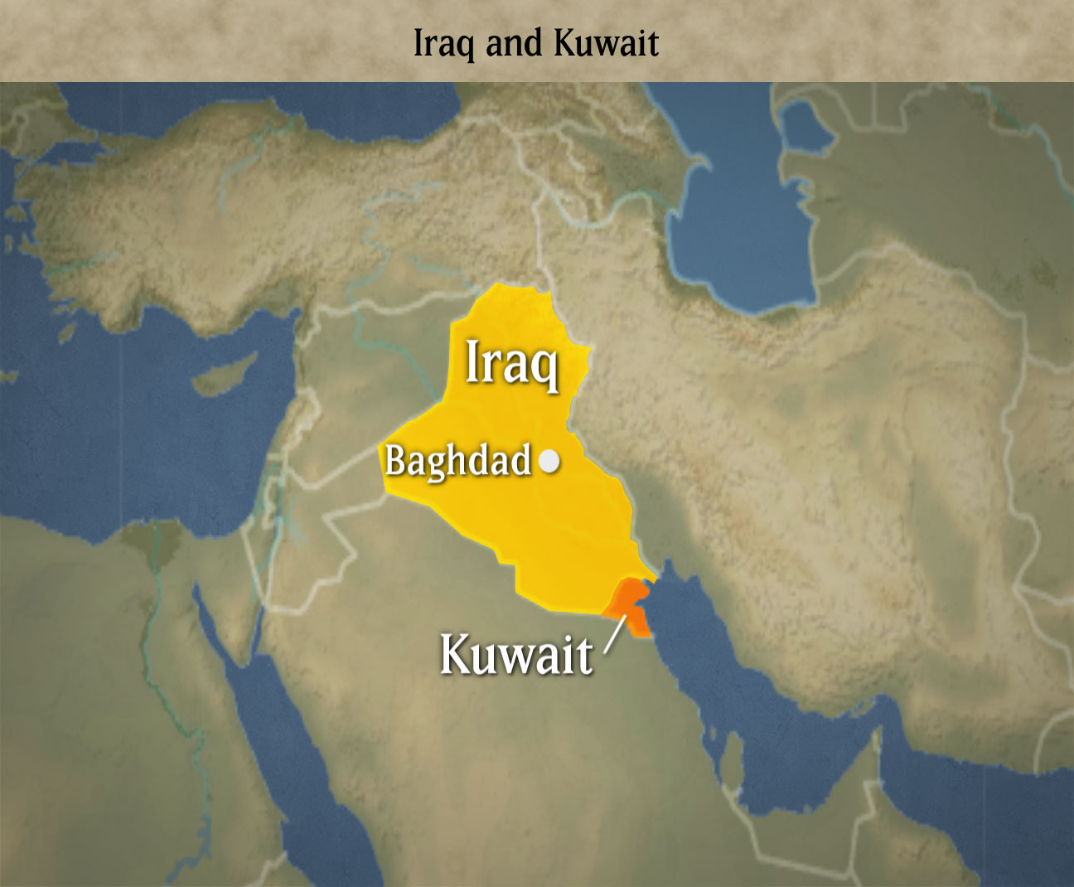
© Brain Wrinkles

Slide 15
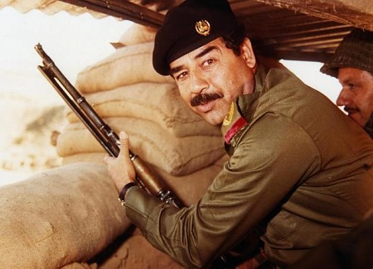
Saddam Hussein
© Brain Wrinkles

Slide 16
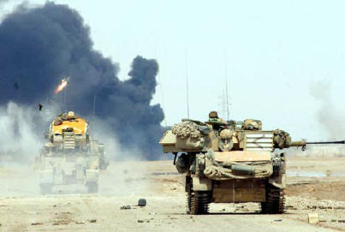
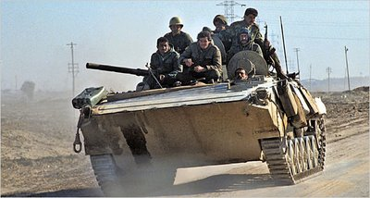
August 2nd, 1990 –
Iraq invades Kuwait
© Brain Wrinkles

Slide 17
Desert Storm
In order to survive the attack, the small country of Kuwait knew it would need allies.
The US was concerned about this invasion, as a lot of the country’s oil came from Kuwait & Saudi Arabia.
In January 1991, the United States and a group of other countries started “Operation Desert Storm”, a military mission to recapture Kuwait.
© Brain Wrinkles

Slide 18
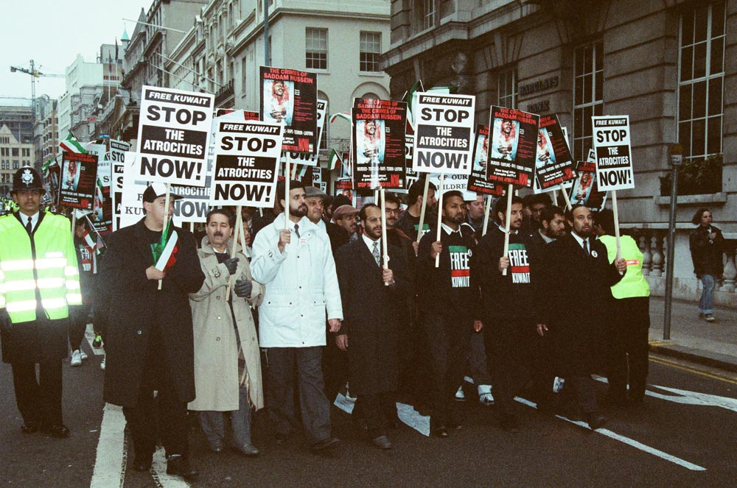
© Brain Wrinkles

Slide 19
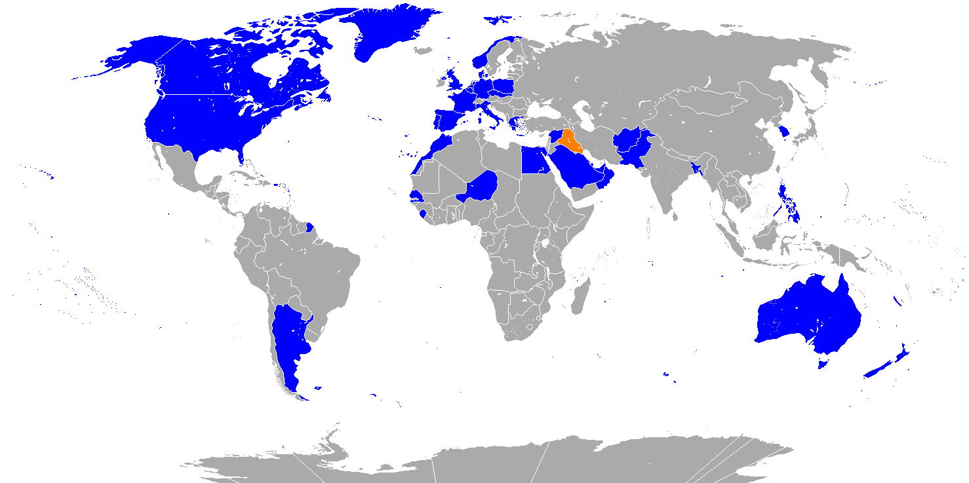
Blue = Coalition Nations
© Brain Wrinkles

Slide 20
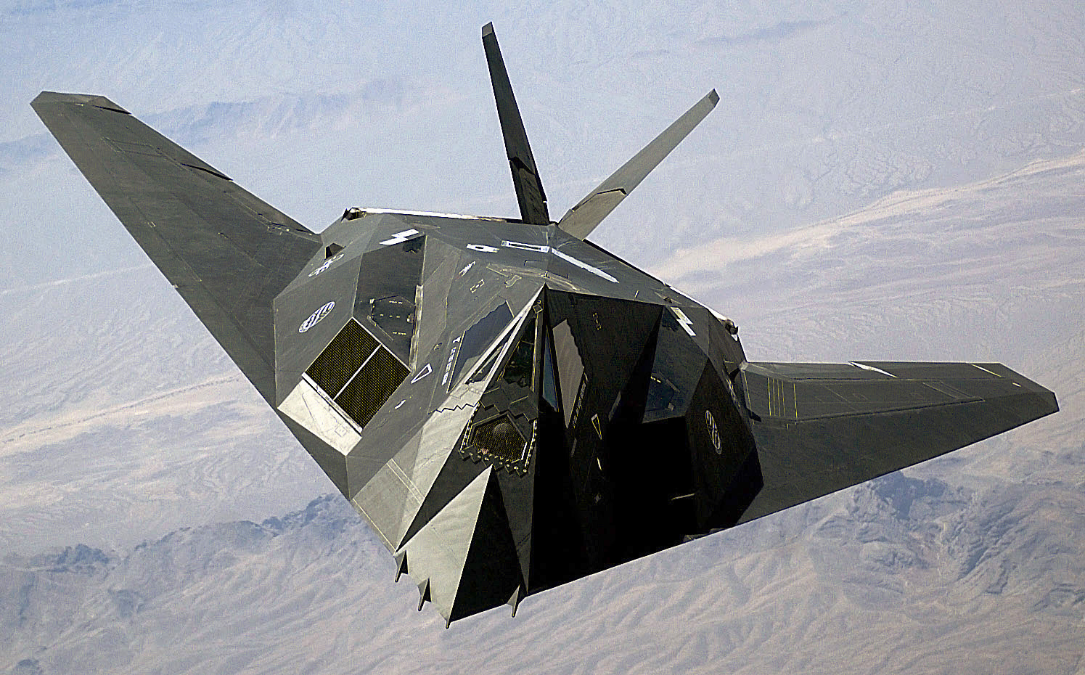
A US Nighthawk – one of the key players in Desert Storm.
© Brain Wrinkles

Slide 21
Desert Storm
The coalition employed missile attacks and used ground forces to quickly drive Iraqi forces out of Kuwait in just six weeks.
By February of 1991, the Iraqi government agreed to a truce and withdrew from Kuwait.
Iraq left, but not before Saddam Hussein had his soldiers set nearly 1,000 oil fields on fire, causing immense environmental damage.
Both Iraq and Kuwait were badly damaged during the war.
© Brain Wrinkles

Slide 22
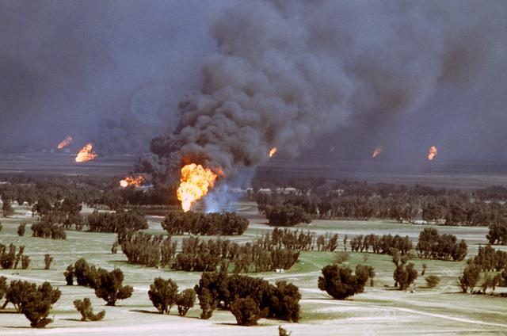
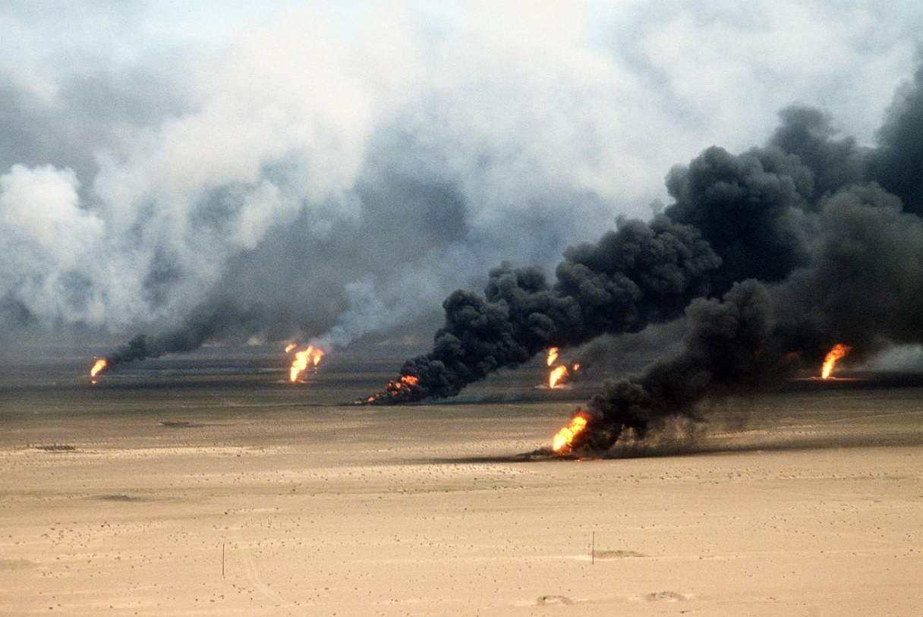
Oil fires set in Kuwait
by Iraqi forces.
© Brain Wrinkles

Slide 23
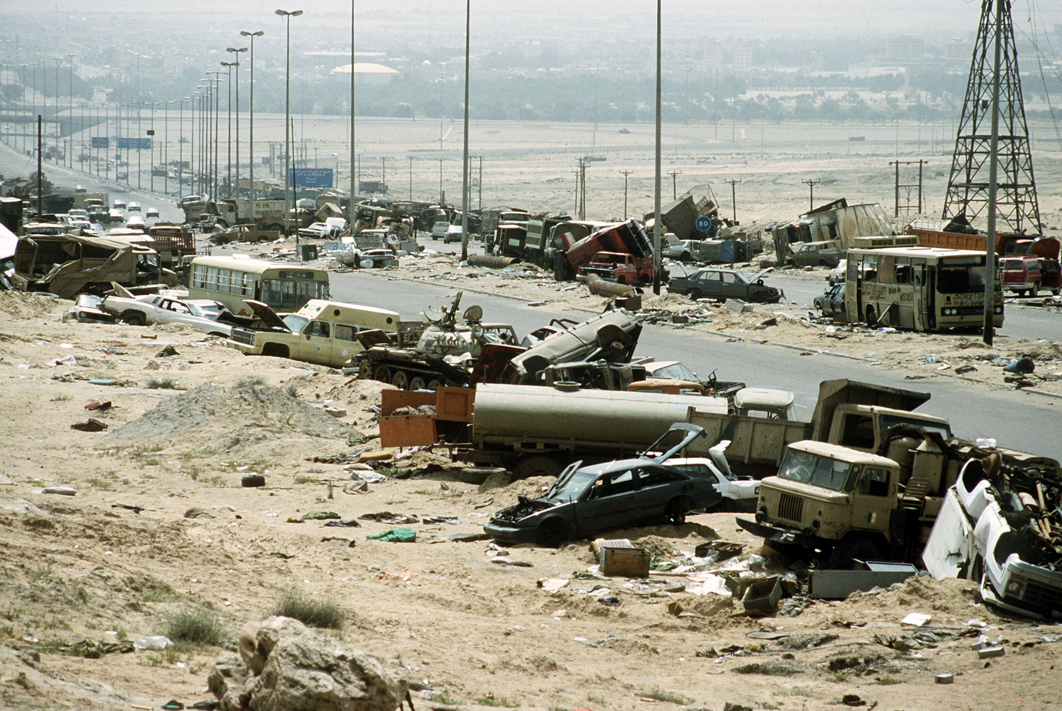
Destroyed military & civilian vehicles along the “Highway of Death”, a six mile stretch of road between Kuwait and Iraq.
© Brain Wrinkles

Slide 24
UN Embargo
When Iraq invaded Kuwait, the United Nations imposed an embargo that prevented Iraq from exporting oil or importing goods.
The UN would not lift the embargo until Iraq destroyed its chemical and biological weapons and promised to stop making nuclear weapons.
This process began in 1991, and when the UN inspection team left in 1998, there was speculation that only 85% had actually been destroyed.
© Brain Wrinkles

Slide 25
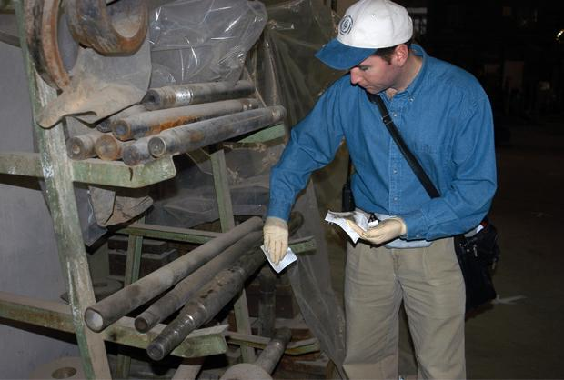
UN weapons inspector taking samples at an Iraqi factory in 2002.
© Brain Wrinkles

Slide 26
Iraq
Invasion
Operation Iraqi Freedom
© Brain Wrinkles

Slide 27
Iraq
After the UN inspection team left, many Americans believed that Hussein was hiding weapons of mass destruction (WMDs) throughout the country, as well as providing aid to members of al-Qaeda.
In 2003, the United States, Great Britain, Australia, & other countries launched a military invasion of Iraq called “Operation Iraqi Freedom”.
© Brain Wrinkles

Slide 28
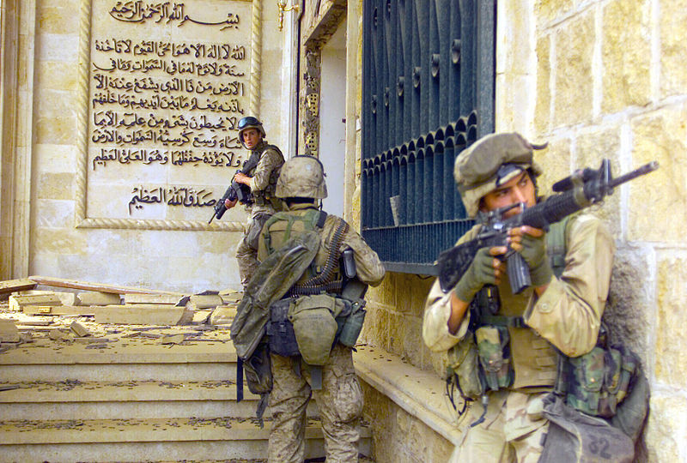
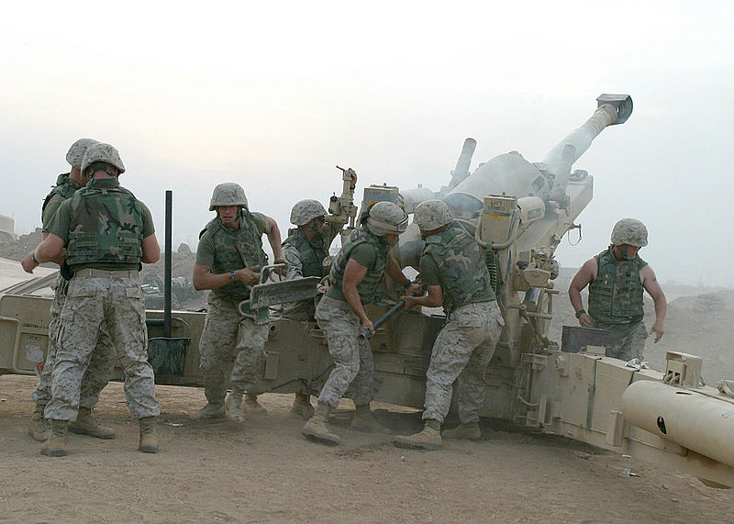
U.S. marines enter a palace in Baghdad.
U.S. marines fire a M198 Medium Howitzer.
© Brain Wrinkles

Slide 29
Results
Saddam Hussein’s government collapsed quickly, and the military operation was over in less than two months.
No WMDs were ever found.
In December 2003, Hussein was captured, tried, and sentenced to death.
He was executed in December 2006.
© Brain Wrinkles

Slide 30
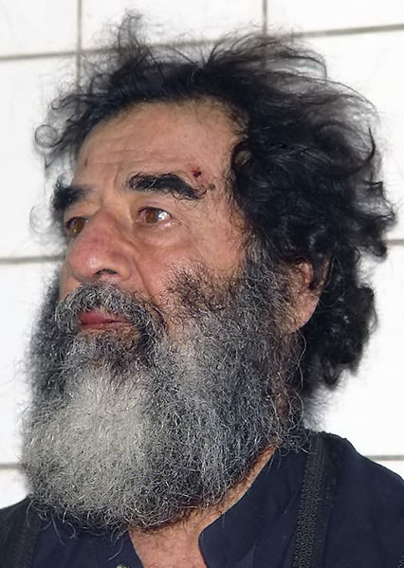
Saddam Hussein was found hiding in a hole armed with a pistol, an AK-47 assault rifle, and $750,000 cash.
© Brain Wrinkles

Slide 31
Iraq Today
Rebuilding Iraq after the invasion has been difficult.
In 2005, Iraqi citizens took part in free elections to establish a new democratic government.
U.S. forces remained in Iraq until the new Iraqi government was secure and stable.
In December 2011, the U.S. forces withdrew.
Unfortunately, there is still conflict in Iraq today, as the Shia and Sunni Muslims are fighting one another for power of the country.
© Brain Wrinkles

Slide 32
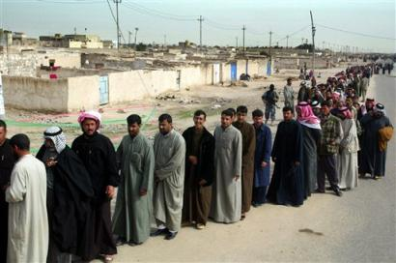
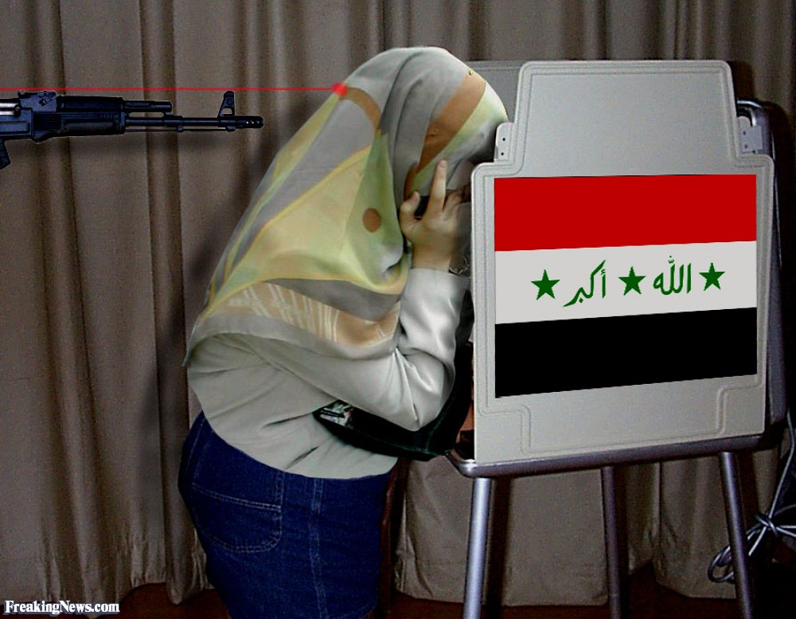
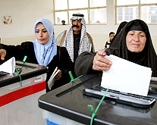
© Brain Wrinkles

Slide 33
Afghanistan
Invasion
Operation Enduring
Freedom
© Brain Wrinkles

Slide 34
Bin Laden
In 1996, the Taliban (an extremely religious group) established power in Afghanistan.
The anti-American Taliban was thought to be harboring Osama bin Laden’s terrorist group al-Qaeda, whose goal was to bring an end to Western influence in the Middle East.
The U.S. government identified bin Laden as the most likely suspect responsible for the September 11th, 2001 attacks on the World Trade Center and the Pentagon.
© Brain Wrinkles

Slide 35
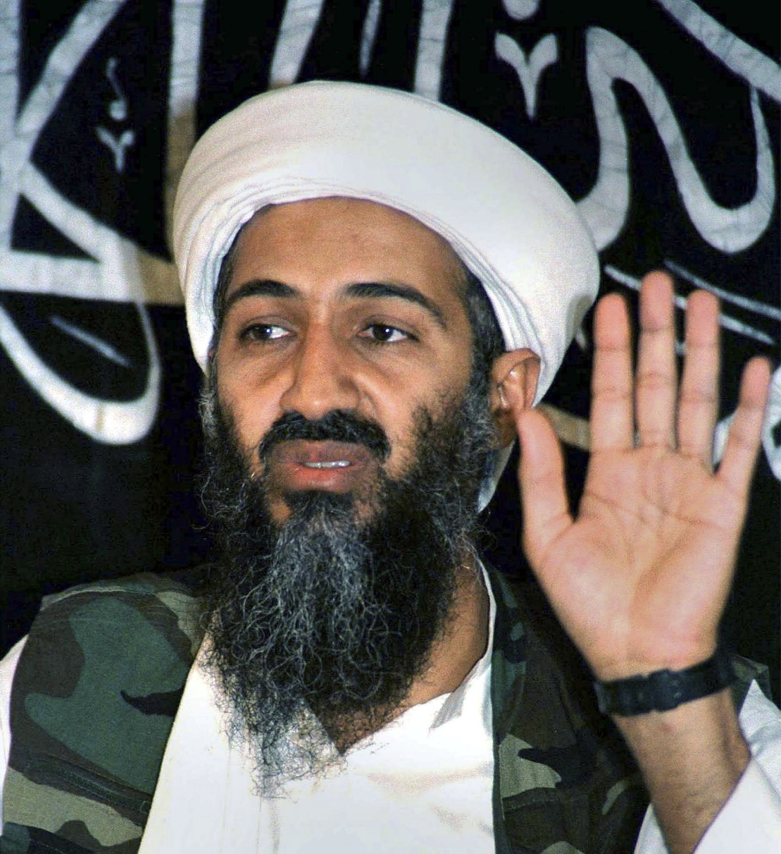
Osama bin Laden
© Brain Wrinkles

Slide 36
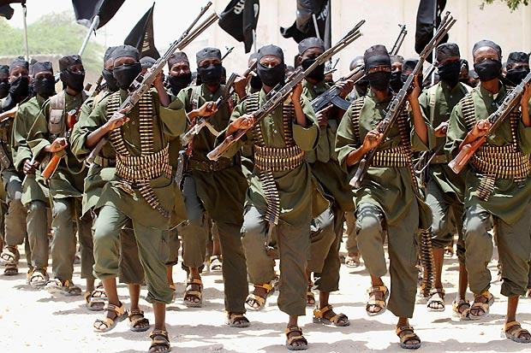
Al-Qaeda
© Brain Wrinkles

Slide 37
9/11
On September 11, 2001, al-Qaeda attacked three targets in the United States.
The terrorists hijacked four planes.
Two planes crashed into the World Trade Center in New York City.
Another airplane crashed into the Pentagon in Virginia, just outside of Washington, DC.
The fourth plane was intended to hit the White House, but crashed in rural Pennsylvania.
Over 3,000 people were killed in these attacks.
© Brain Wrinkles

Slide 38
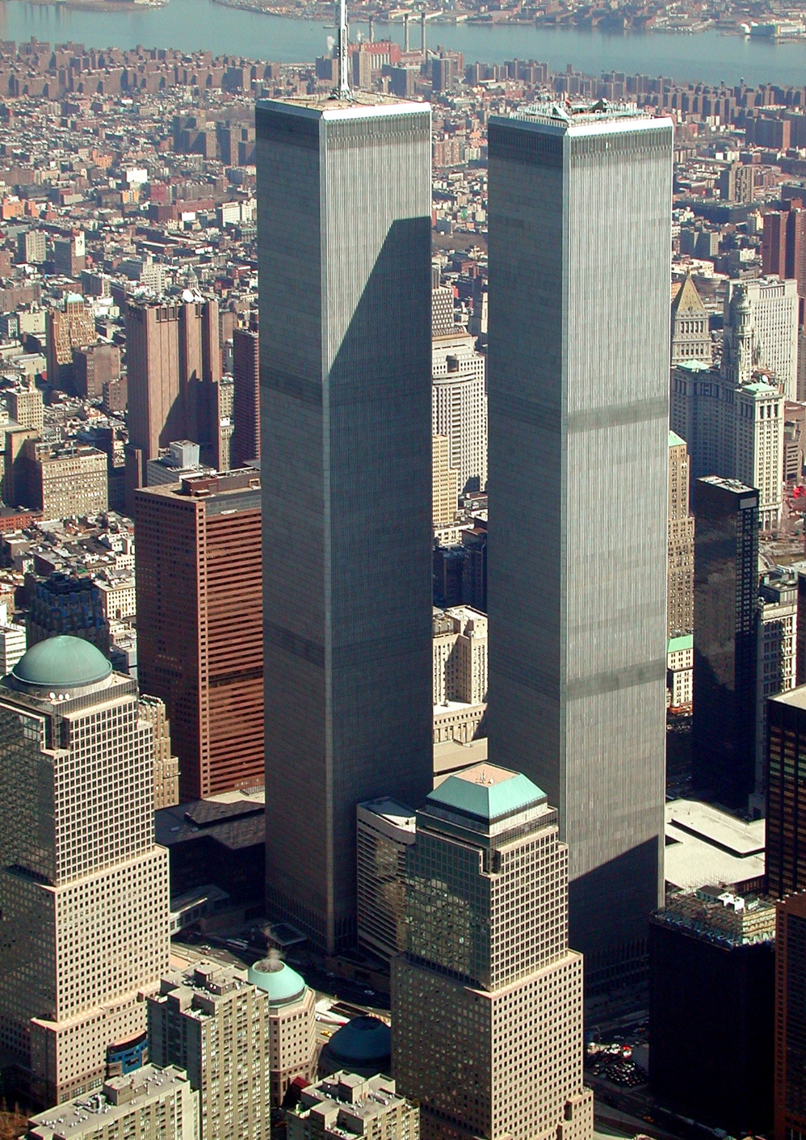
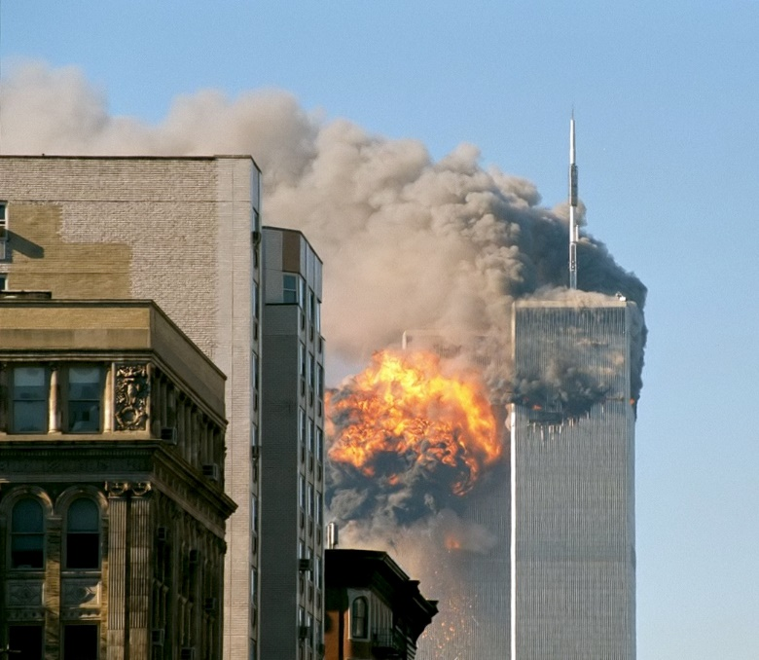
Two days after the September 11 attacks, U.S. President George W. Bush stated: "The most important thing is for us to find Osama bin Laden. It is our number one priority and we will not rest until we find him.”
© Brain Wrinkles

Slide 39
US Invasion
Sources in the U.S. government believed that the Taliban was allowing Bin Laden and his followers to hide out in the mountains of Afghanistan.
On October 7th, 2001, U.S. troops entered Afghanistan to disable the Taliban and locate bin Laden.
© Brain Wrinkles

Slide 40
Democracy
After launching a series of attacks, the Taliban was defeated.
The U.S. helped form a new democratic government in Afghanistan.
Efforts to locate bin Laden failed, and he went into hiding for the next ten years.
© Brain Wrinkles

Slide 41
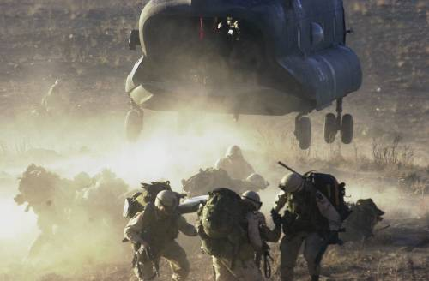
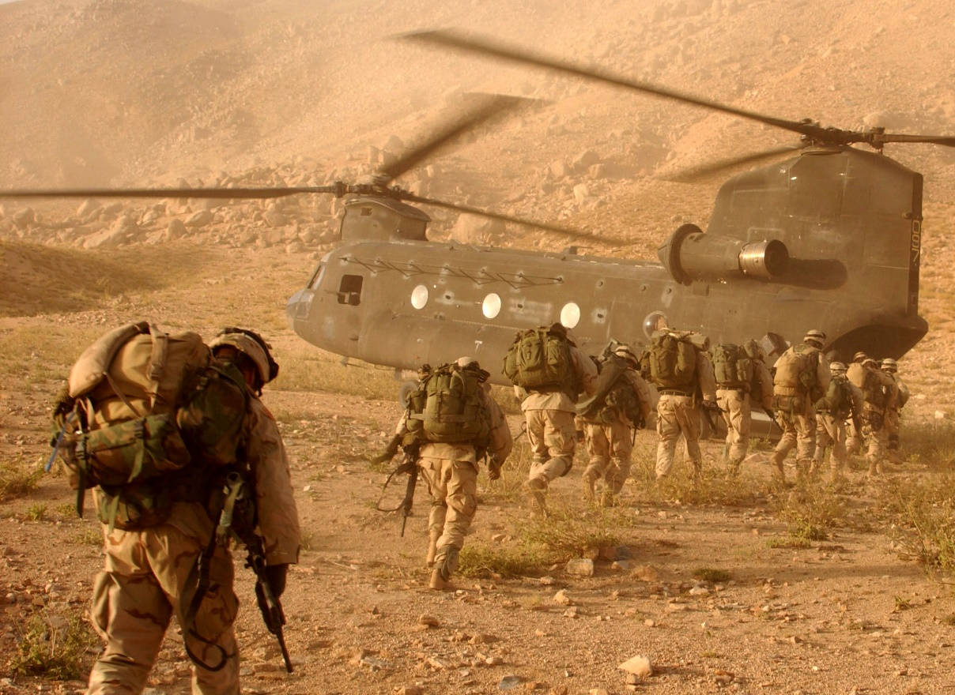
U.S. troops in Afghanistan in 2001.
© Brain Wrinkles

Slide 42
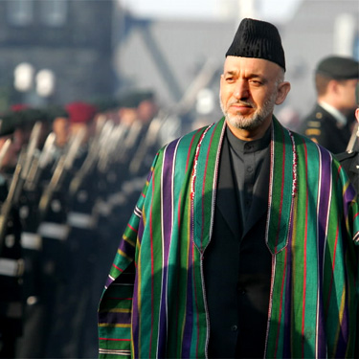
2004 – Hamid Karzai became the first democratically elected president of Afghanistan.
© Brain Wrinkles

Slide 43
The End
On May 2, 2011, at 1:00 am, Navy SEALS raided Osama bin Laden’s compound in Pakistan.
Bin Laden was shot and killed in the raid.
His body was taken to Afghanistan for identification, then buried at sea within 24 hours.
According to U.S. officials, bin Laden was buried at sea because no country would accept his remains.
© Brain Wrinkles

Slide 44
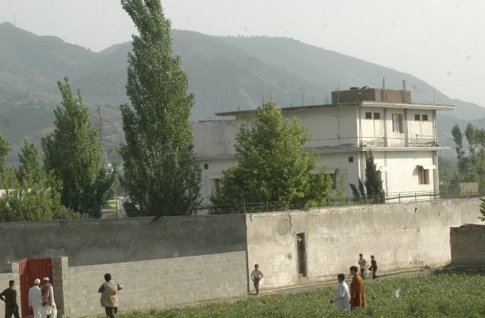
Osama bin Laden’s compound in Pakistan where he was found in 2011.
© Brain Wrinkles

Slide 45
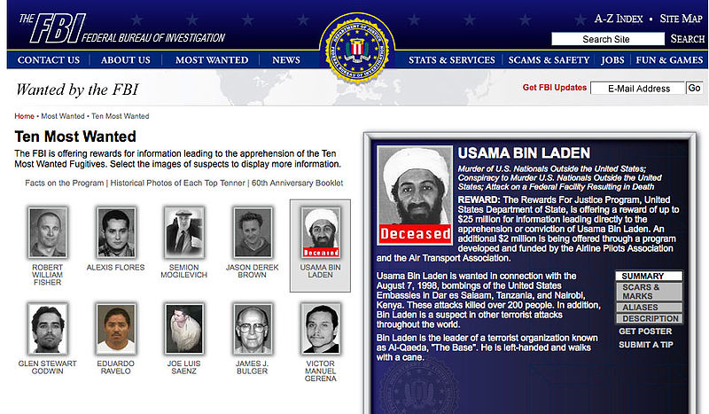
© Brain Wrinkles

